Slide 1
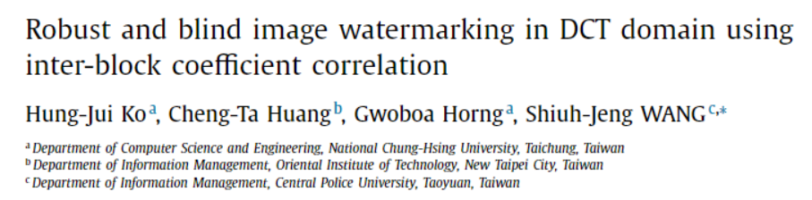
SPEAKER：M10907324 Wu,Zun-Yi 吳俊逸 20201224

Slide 2
OUTLINE
Abstract
Introduction
Proposed method
Experimental results and discussions
Conclusion

Slide 3
Abstract

Slide 4
Abstract
This study presents a robust and transparent watermarking method that exploits blockbased discrete cosine transform (DCT) coefficient modification.
Experimental results demonstrate that the proposed method possesses great robustness against various single and combined attacks.
Notes:
Copyright violations have increased owing to the recent advancements in Internet technologies.
Consequently, digital image watermarking is used to prevent the copyright violations.

Slide 5
Introduction

Slide 6
Introduction
Why they use DCT?
1. DWT is used for JPEG2000.
2. SVD is more complex than DCT and DWT.
3. FT is not good at against geometric attacks.
DCT is popular in the transform domain
Notes:
Spatial domain techniques have lower computational complexity than the transformed domain techniques but tend to be less robust.
On the contrary, the transformed domain techniques feature higher computational complexity with greater robustness.

Slide 7
Introduction
Patra
1. Based on Chinese remainder theorem (CRT).
2. This scheme has low computational complexity and is robust against common image processing attacks.

Slide 8
Introduction
Golabi
1. Based on the features of radical moment.
2. Not good at robust against cropping attacks.
3. Can be embedded into a 512 × 512 cover image only 127 bits.
4. Is goot at robust against rotation and scaling attacks.

Slide 9
Introduction
Das
1. Based on the inter-block coefficient correlation in DCT.
2. Watermark logo being restricted image because some blocks on the border cannot be used for embedding.
3. This scheme is robust against JPEG compression and common image attacks

Slide 10
Introduction
Parah
1. Based on inter-block coefficient differencing in DCT.
2. They considered all blocks and made use of the coefficient differences for embedding.
3. This scheme can use 64 × 64 watermark for 512 × 512 image and is robust against various attacks.
4. It does not consider the correlation between upper and lower blocks and the quantized factor is fixed to each block coefficient. Consequently, the scheme would be vulnerable to multiple attacks.

Slide 11
Introduction
Contributions from this study are as follows:
1. An innovative inter-block watermarking method suitable for gray and color images.
2. The requirements of robustness and transparency in digital watermarking methods are always a trade-off in applications. The robustness of the proposed method is increased than those in previous work while maintaining high transparency of the watermark in the image.
3. The proposed method is also robust against specific attacks, such as median filter after salt&pepper, five-degree rotation, and 25% cropping.

Slide 12
Proposed method

Slide 13
Proposed method
3.1. Preliminary phase
Step 1. Each pixel value of the original image O is subtracted by 128.
Step 2. Input image O of size W × H is divided into non-overlapping 8 × 8 pixel blocks, resulting in R × C blocks (R = W/8 and C = H/8).
Step 3. Perform DCT for each block. The matrix of DCT blocks is BP,Q, where 1 ≤ P ≤ R and 1 ≤ Q ≤ C.
Step 4. Permute the watermark using a random bit named key.
Notes:
In the preliminary phase, each pixel in the original image is in the range 0–255 (8 bits per pixel). Each pixel value is subtracted by 128, such that the pixel values are in the range −128–127. Then, we divide the image into non-overlapping blocks, and DCT is performed for each block. The operations of the preliminary phase are described as follows.

Slide 14
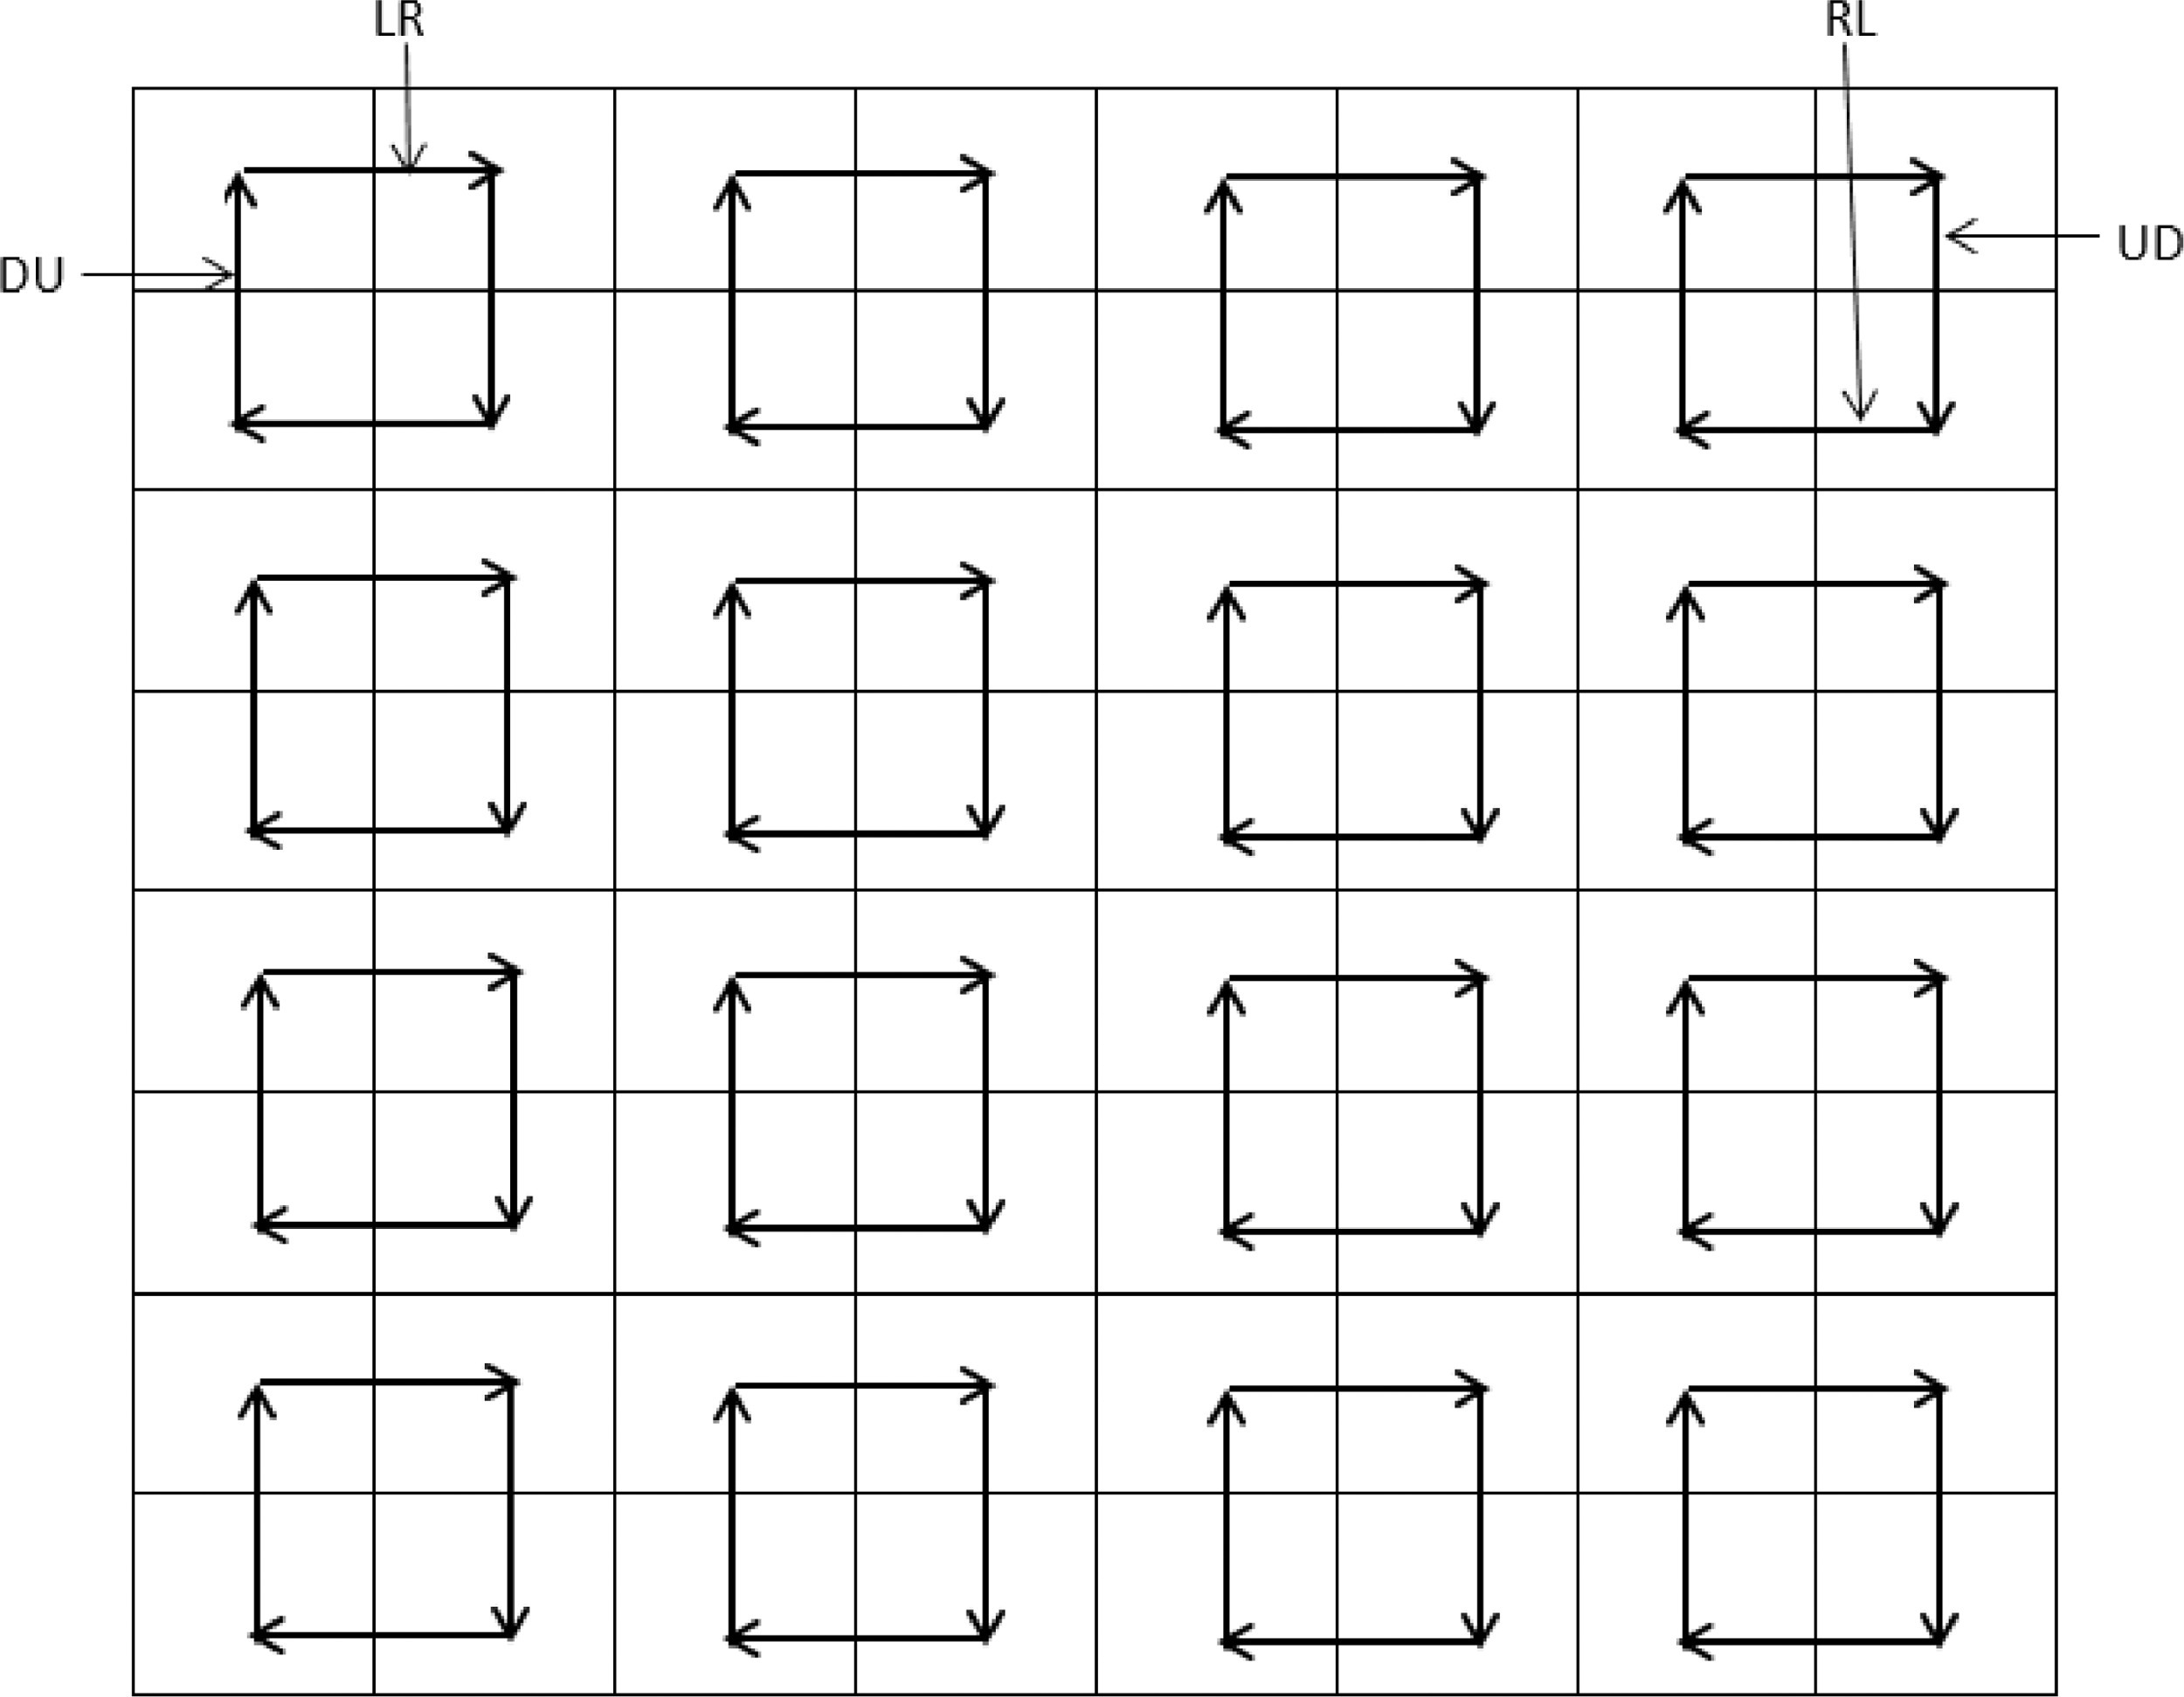
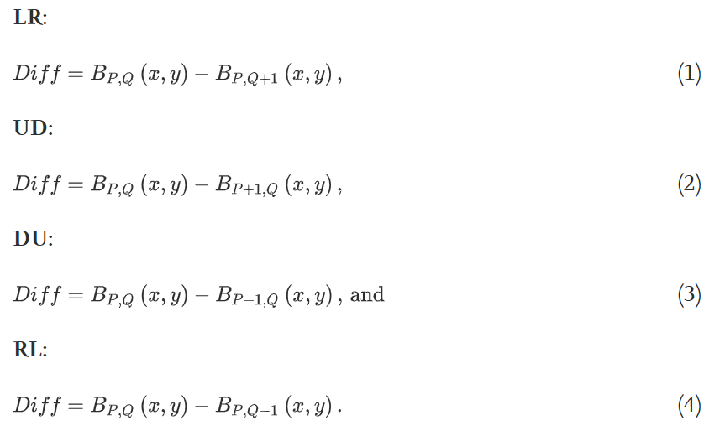
Proposed method
3.2. Watermark embedding phase
Notes:
To embed the watermark bits in the DCT blocks, we calculate the difference between the DCT coefficients of the adjacent blocks. The difference is denoted as “Diff.”

Slide 15
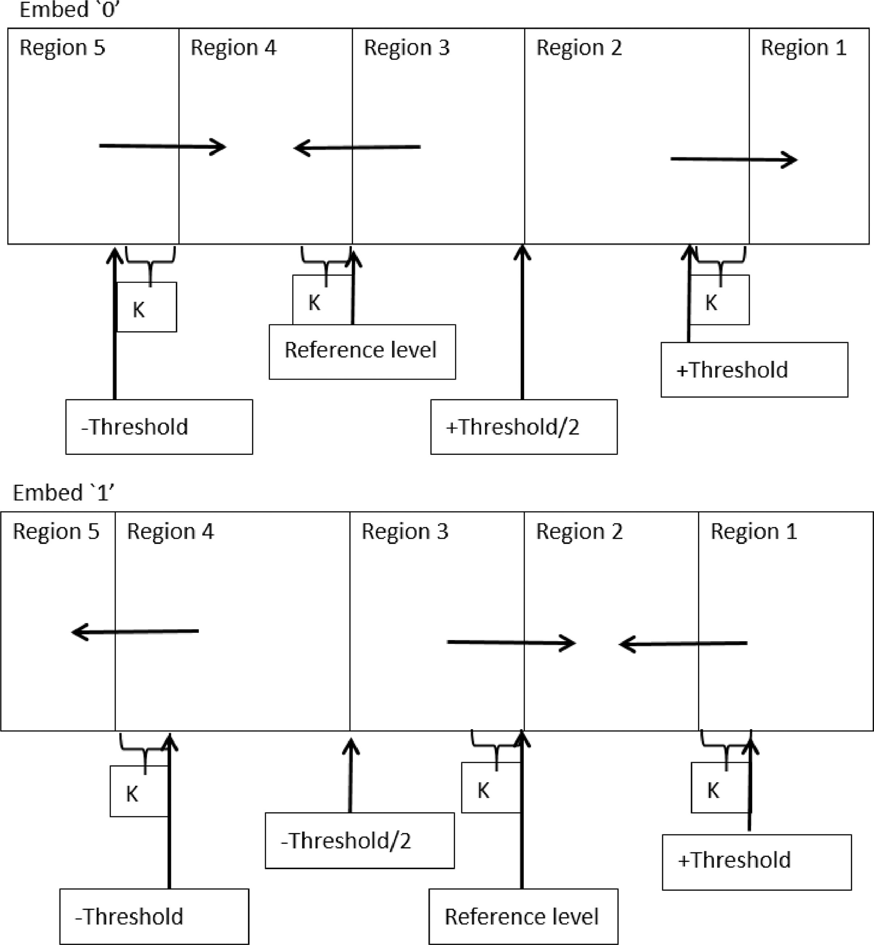
Proposed method
Notes:
Embedding bit 0 If Diff belongs to region 3 or 5, the BP,Q (x, y) is modified to shift the Diff to region 4. If Diff belongs to region 2, the BP,Q (x, y) is modified to shift the Diff to region 1.
Embedding bit 1 If Diff belongs to region 1 or 3, the coefficient BP,Q(x, y) is modified to shift the Diff to region 2. If Diff belongs to region 5, the modified coefficient shifts Diff to region 4

Slide 16
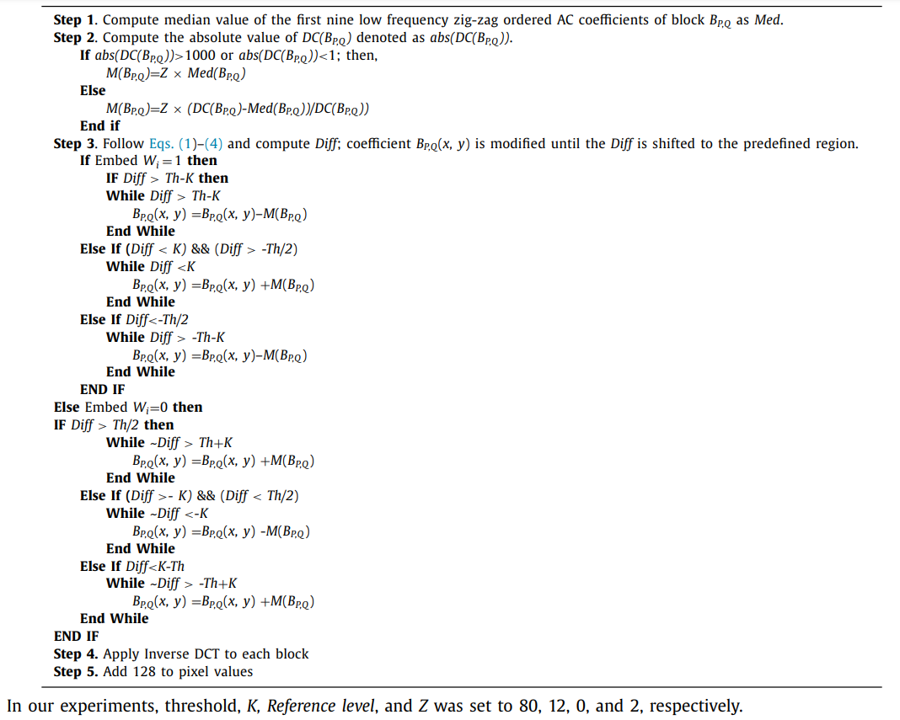
Proposed method
The process of watermark embedding is described as follows.

Slide 17
Proposed method
3.3. Watermark embedded for color images
1.The red, green and blue planes of the image should be separated first.
2. After the watermark embedding stage, the watermark bits are embedded in each plane.

Slide 18
Proposed method
3.4. Watermark extraction
Step 1. The pixel values of watermarked image OE are subtracted by 128.
Step 2. Divide OE of size W × H into non-overlapping 8 × 8 pixel blocks, resulting in R × C blocks (R = W/8 and C = H/8)
Step 3. DCT is performed for each block, and DCT blocks are denoted as BP,Q, where 1 ≤ P ≤ R and 1 ≤ Q ≤ C
Step 4. Follow Eqs. (1)–(4) to compute Diff; K is set to zero; WMb is the extracted watermark WMb = 0 if Diff falls in region 1 or 4 WMb = 1 if Diff falls in region 2 or 5
Step 5. Recover the extracted watermark using a pseudorandom key

Slide 19
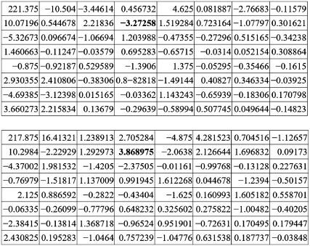
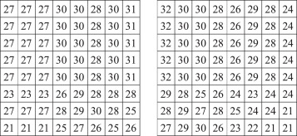
Proposed method
3.5. Example of the proposed embedding/extraction method
scaling variable Z as 2
Threshold (Th) value is 80
K is 0
Notes:
The first two 8×8 blocks are on your left, and the same block after applying DCT is on your right.
In this example, the median of nine AC coefficients in zig-zag order is 0.456732 and DC value is 221.375. As a result, M is 1.995874. We assume that the watermark bit is 1 and target AC coefficient is B(2,4). Herein, Diff would be −7.14156. Therefore, the value −3.27258 must add 1.9958874 iteratively until Diff is greater than K, thereby the new value is 4.707695. When we need to extract the watermark, we already know that B(2,4) is our target. Herein, B(2,4) is 4.707695, the same position of the next block is 3.868975, and Diff is 0.83912. According to the proposed method, the value 0.83912 falls in region 2; therefore, we can extract the watermark bit as 1.

Slide 20

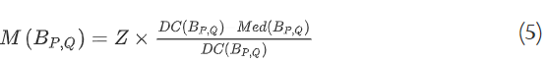
zig-zag order is 0.456732
DC value is 221.375
M is 1.995874
the value −3.27258 must add 1.9958874 iteratively until Diff is greater than K, thereby the new value is 4.707695.

Slide 21
Experimental results and discussions

Slide 22
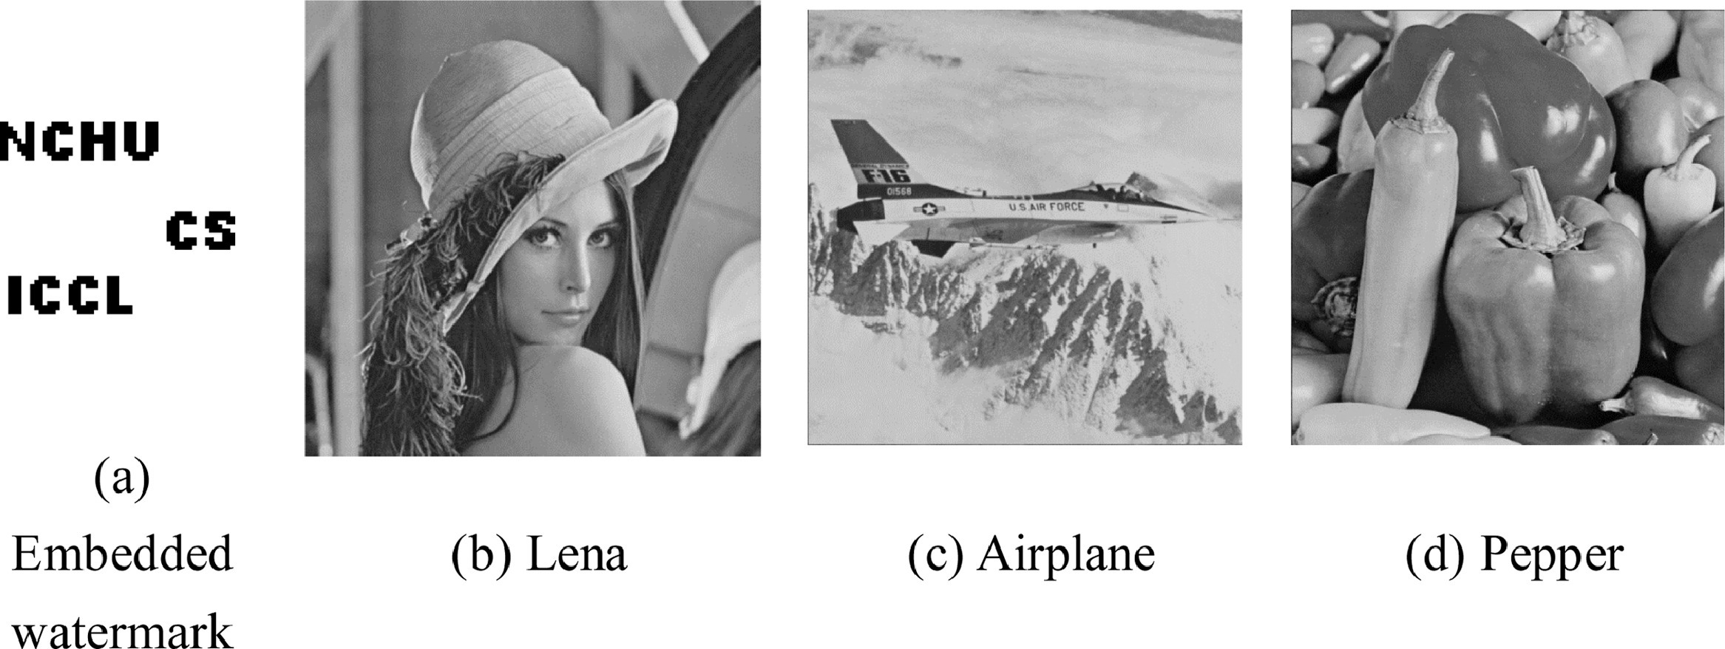
Experimental results and discussions
The proposed method was tested using various attacks.
Each cover image is 512 × 512 and size of watermark is 64 × 64.

Slide 23
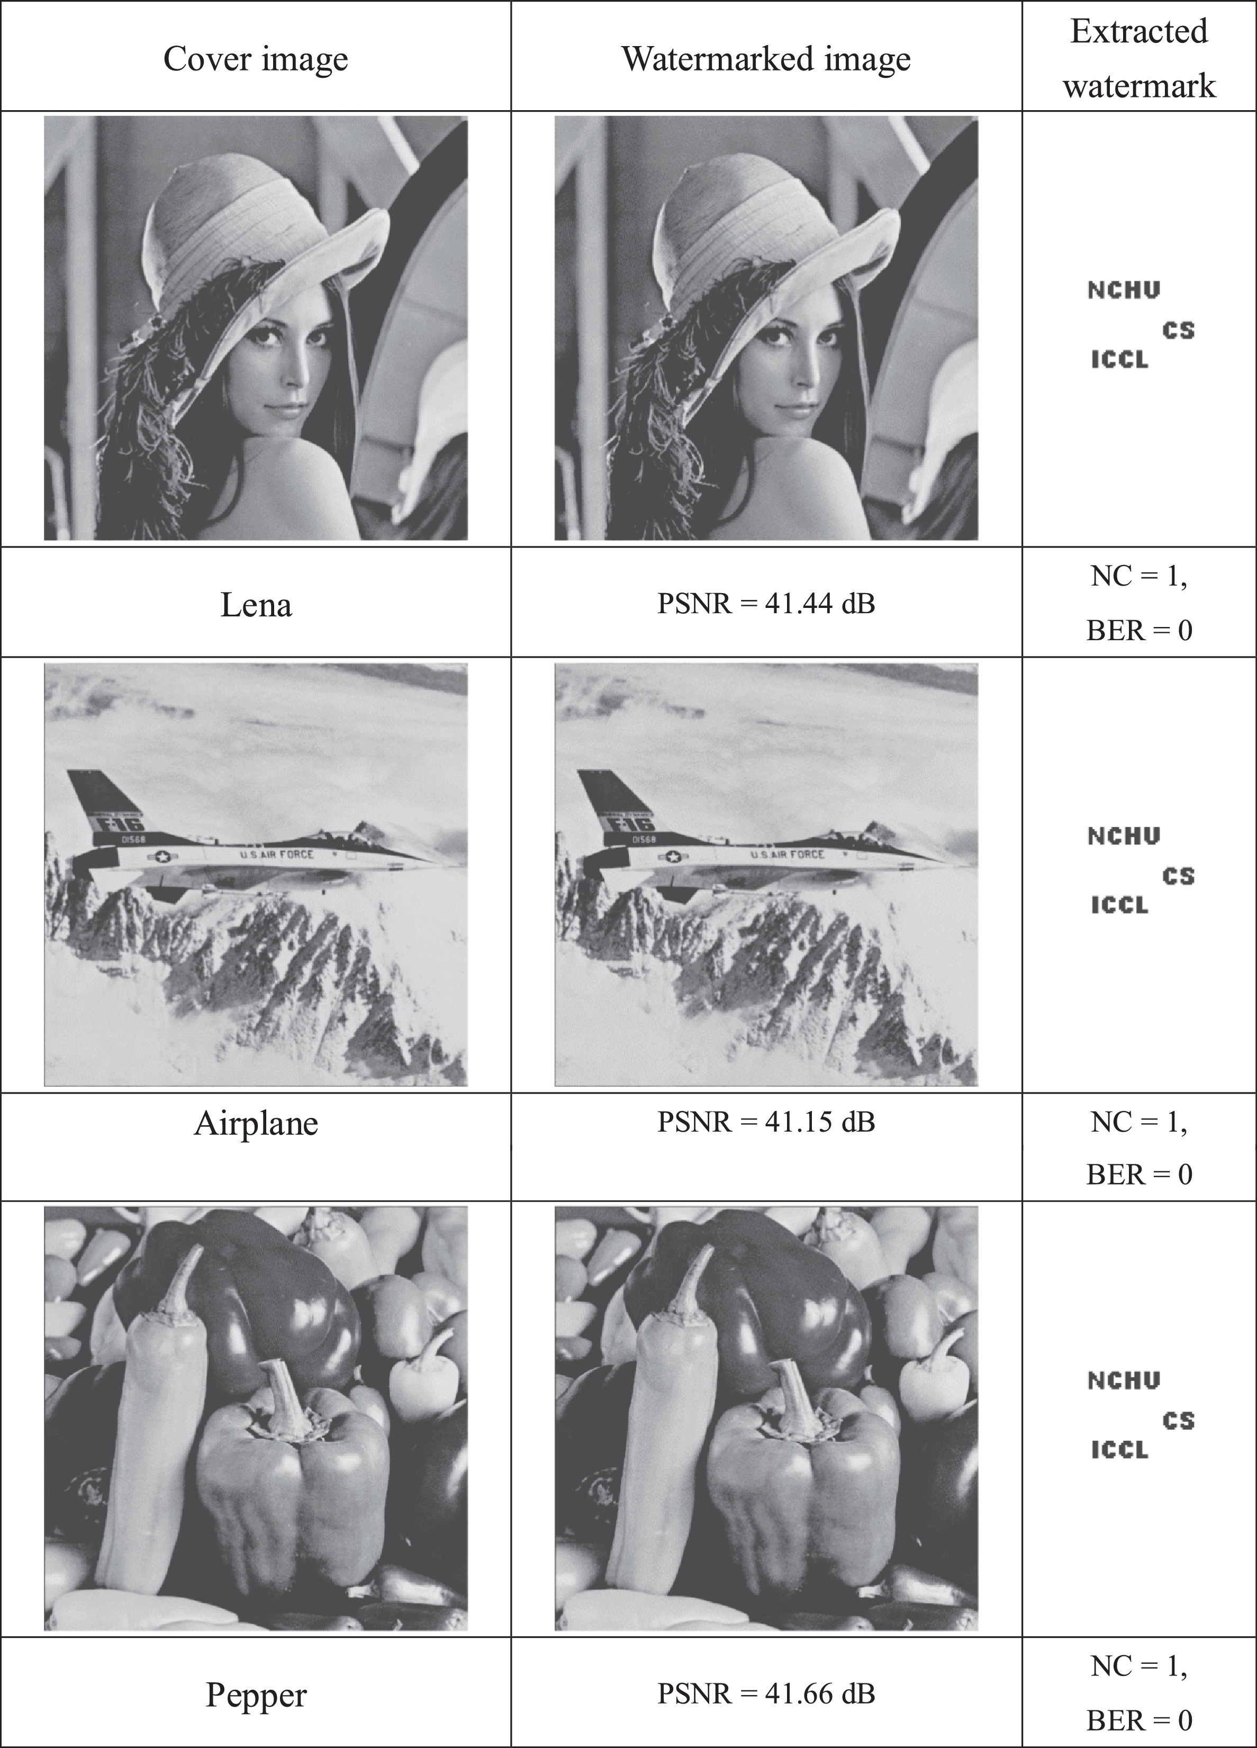
Experimental results and discussions
4.1. Watermark extraction without attack
All the PSNR values of the watermarked images are greater than 41 dB.
Notes:
shows the cover images, watermarked images, and extracted watermarks. For all watermarked images, the watermarks can be extracted using the proposed method.

Slide 24
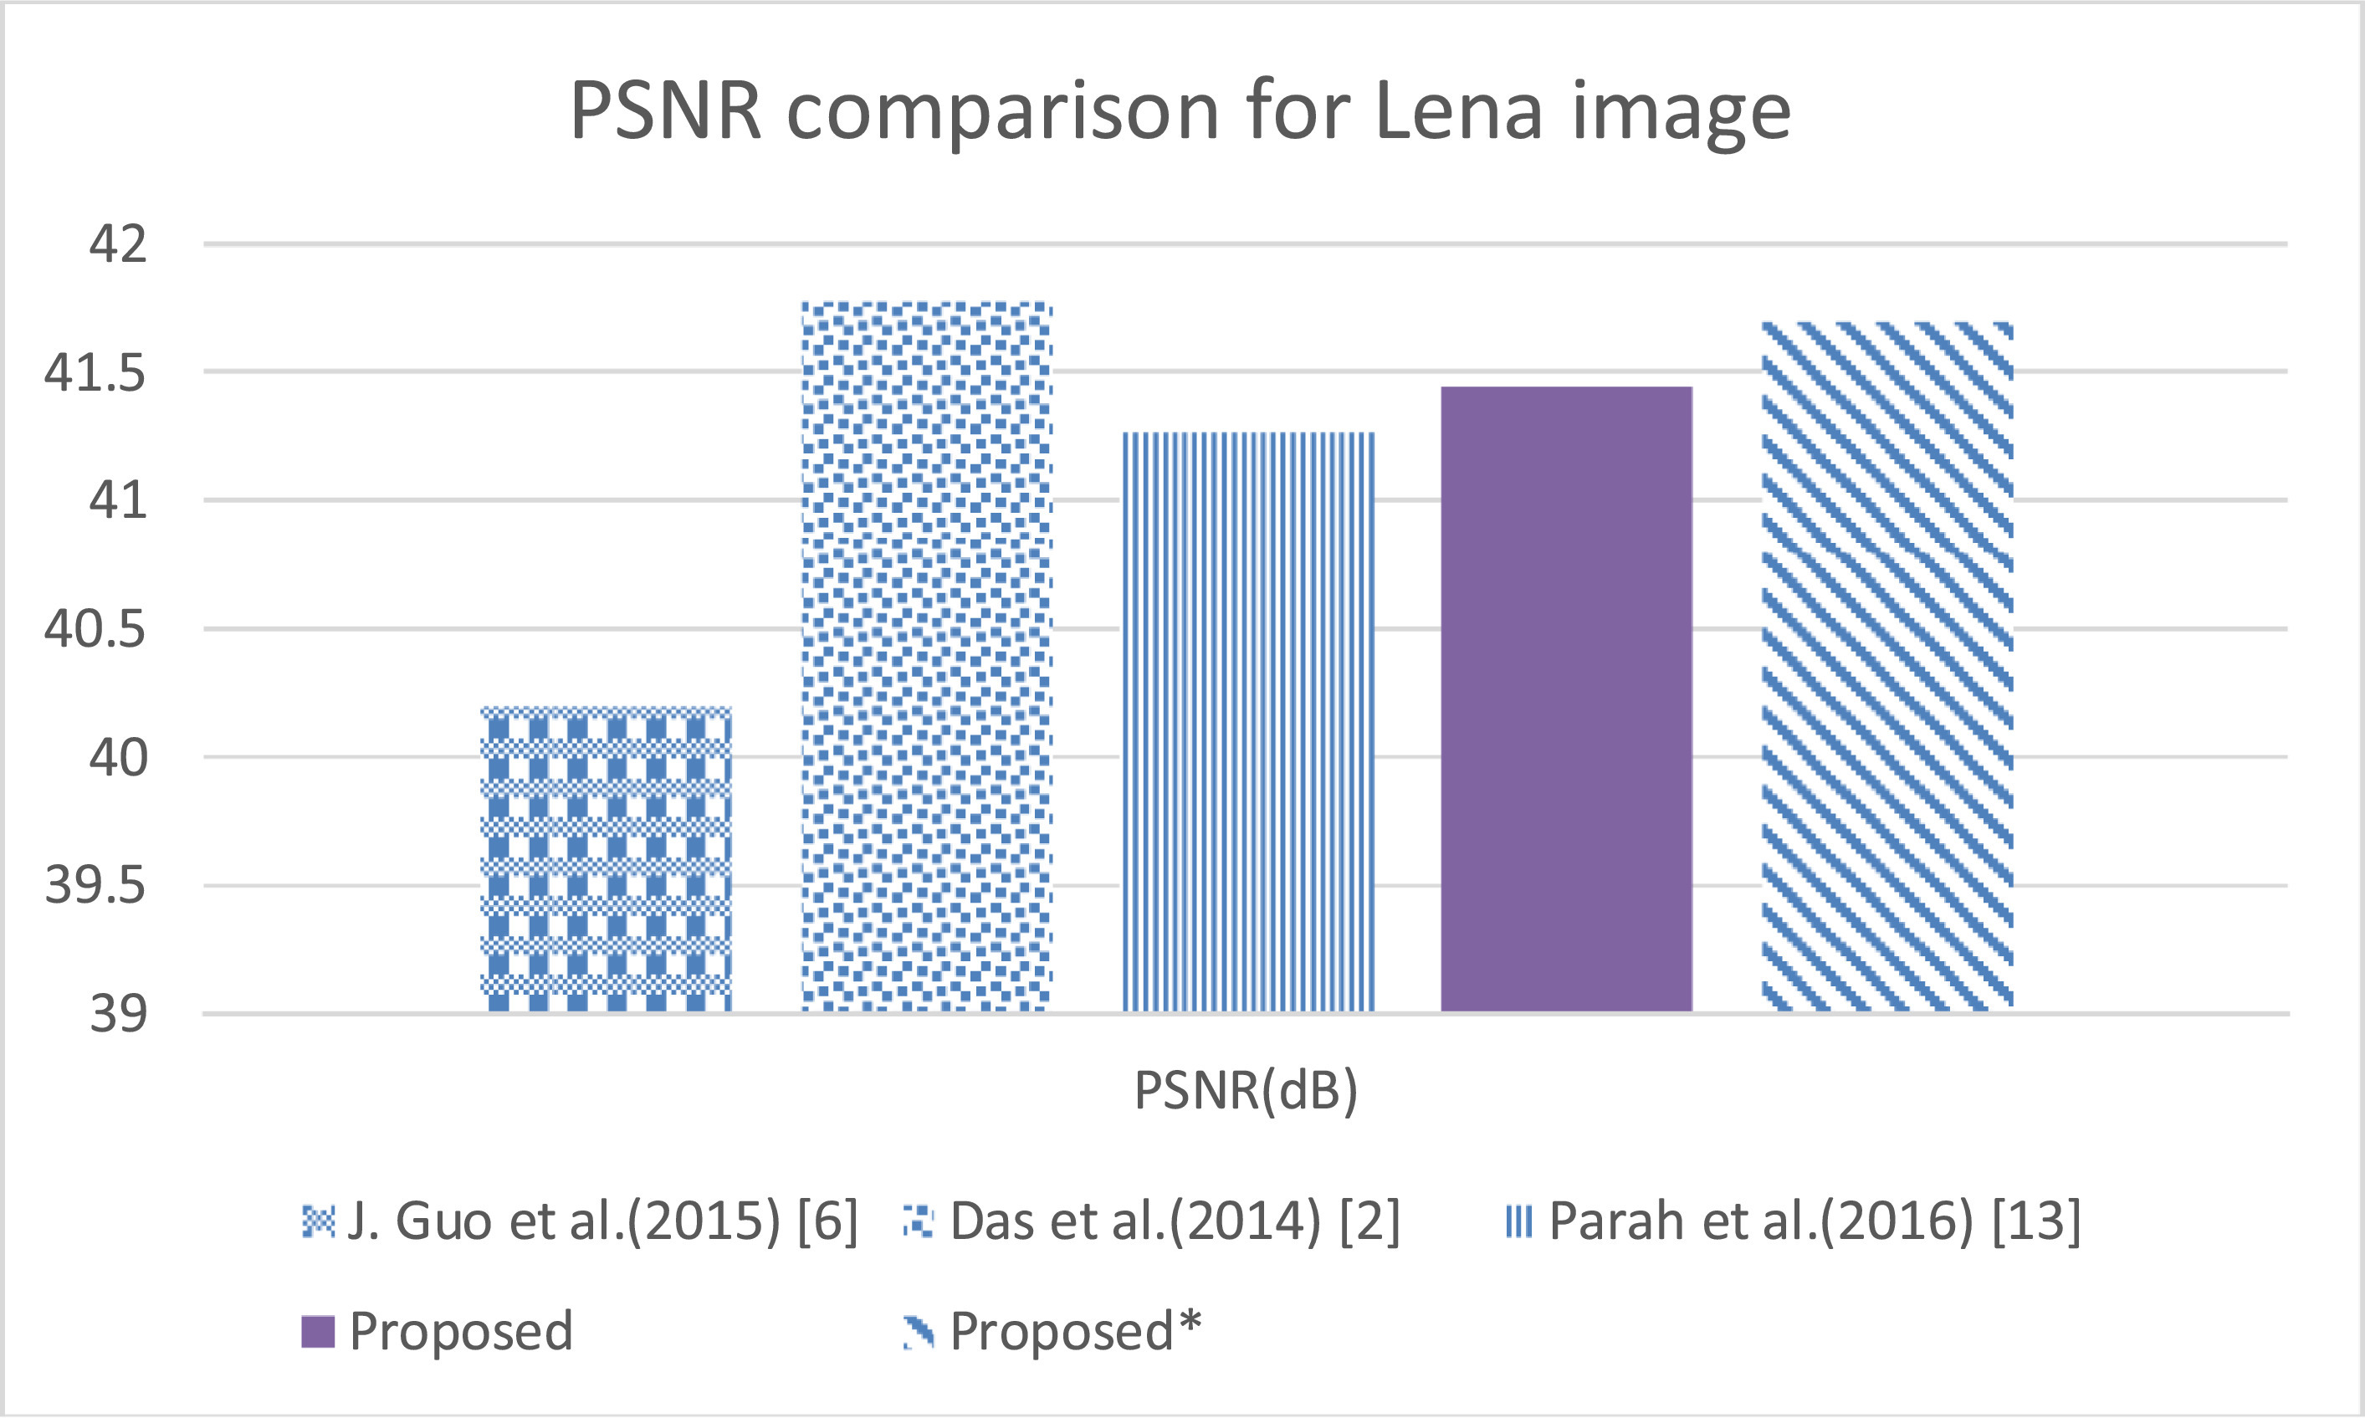
Experimental results and discussions
4.1. Watermark extraction without attack
Notes:
Das et al. is slightly higher because the applied watermark is smaller. If we use the same watermark as the size of 64 × 63 bits from Das et al., then the proposed method achieves nearly the same PSNR as [2] with PSNR difference of only 0.08 dB →proposed∗

Slide 25
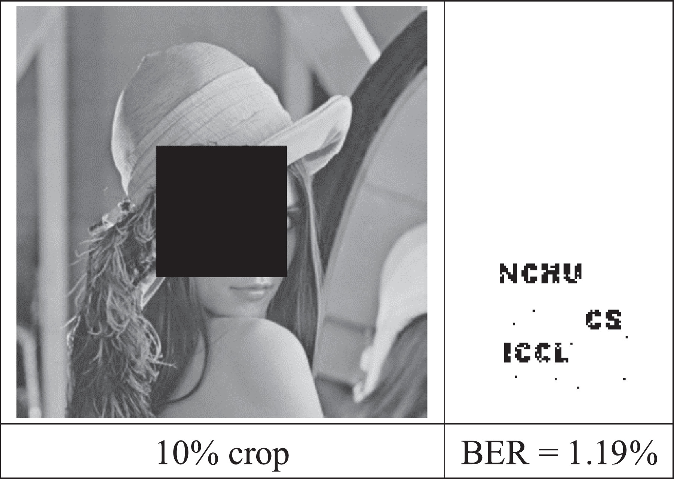
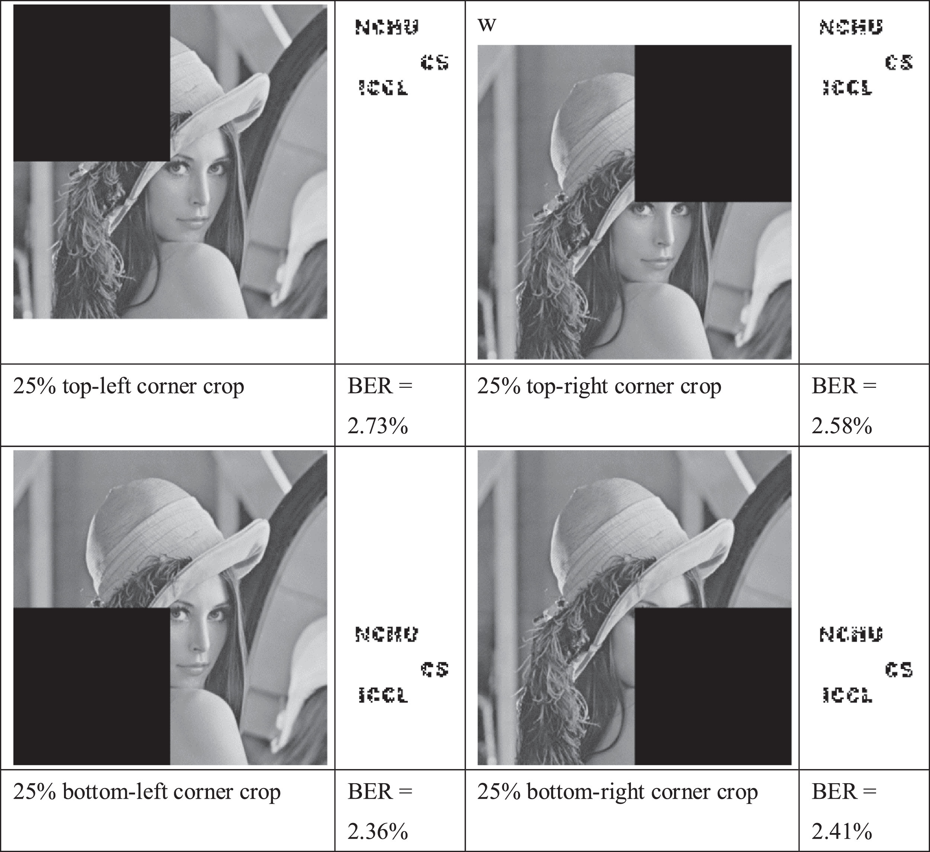
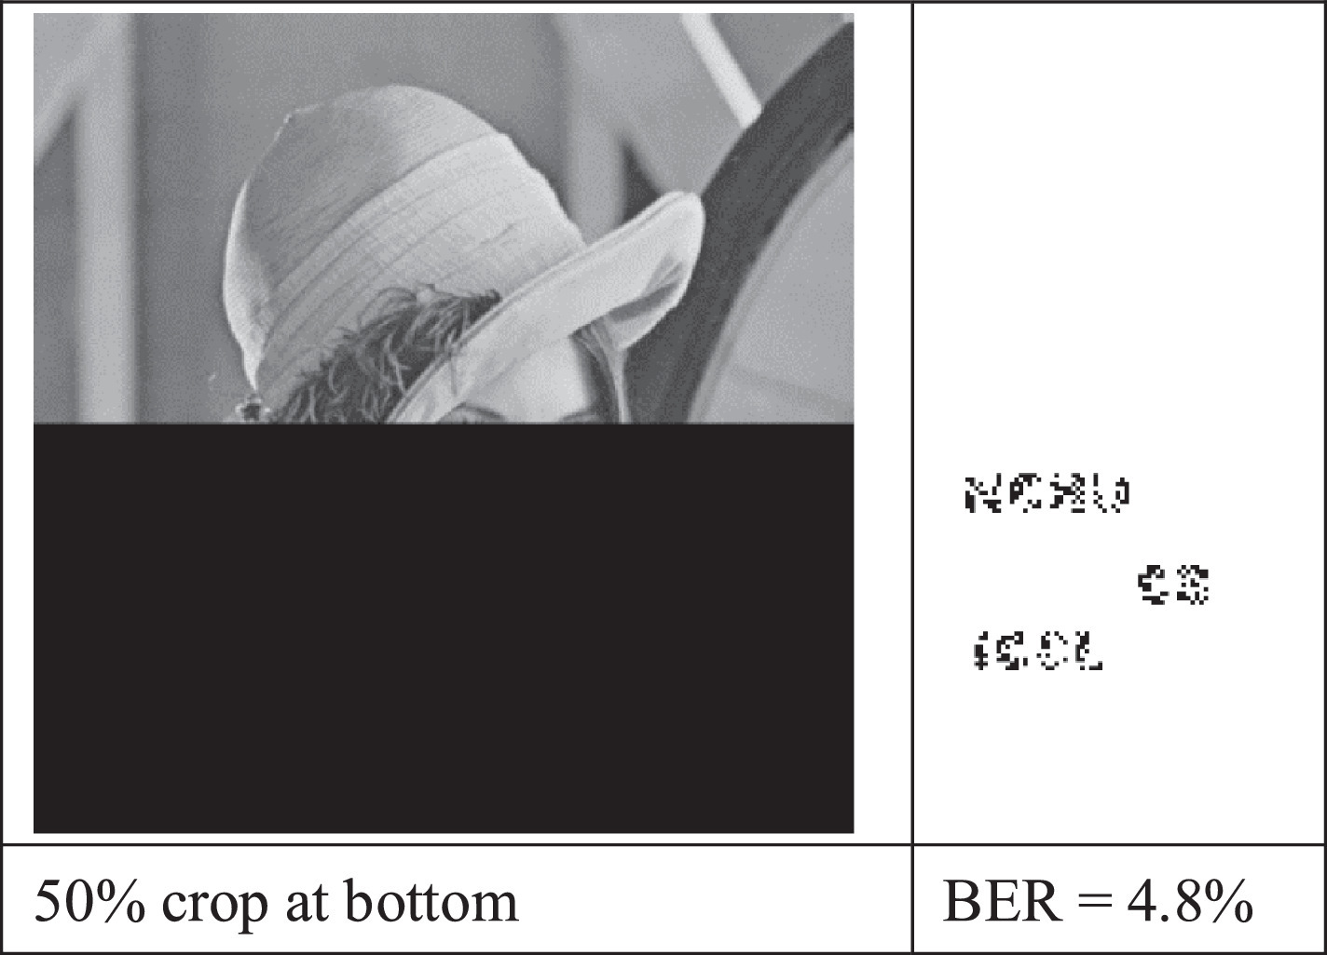
Experimental results and discussions
4.2.1. Watermark extraction after cropping attacks
Notes:
The left image shows a 10% crop in the center of the image, and the BER of the extracted watermark is 1.19%.
The middle image shows a 25% cropped Lena image (in different areas) with an average BER value of 2.52%.
The image on the right shows a 50% bottom cropped Lena image with an average BER value of 4.8%.

Slide 26
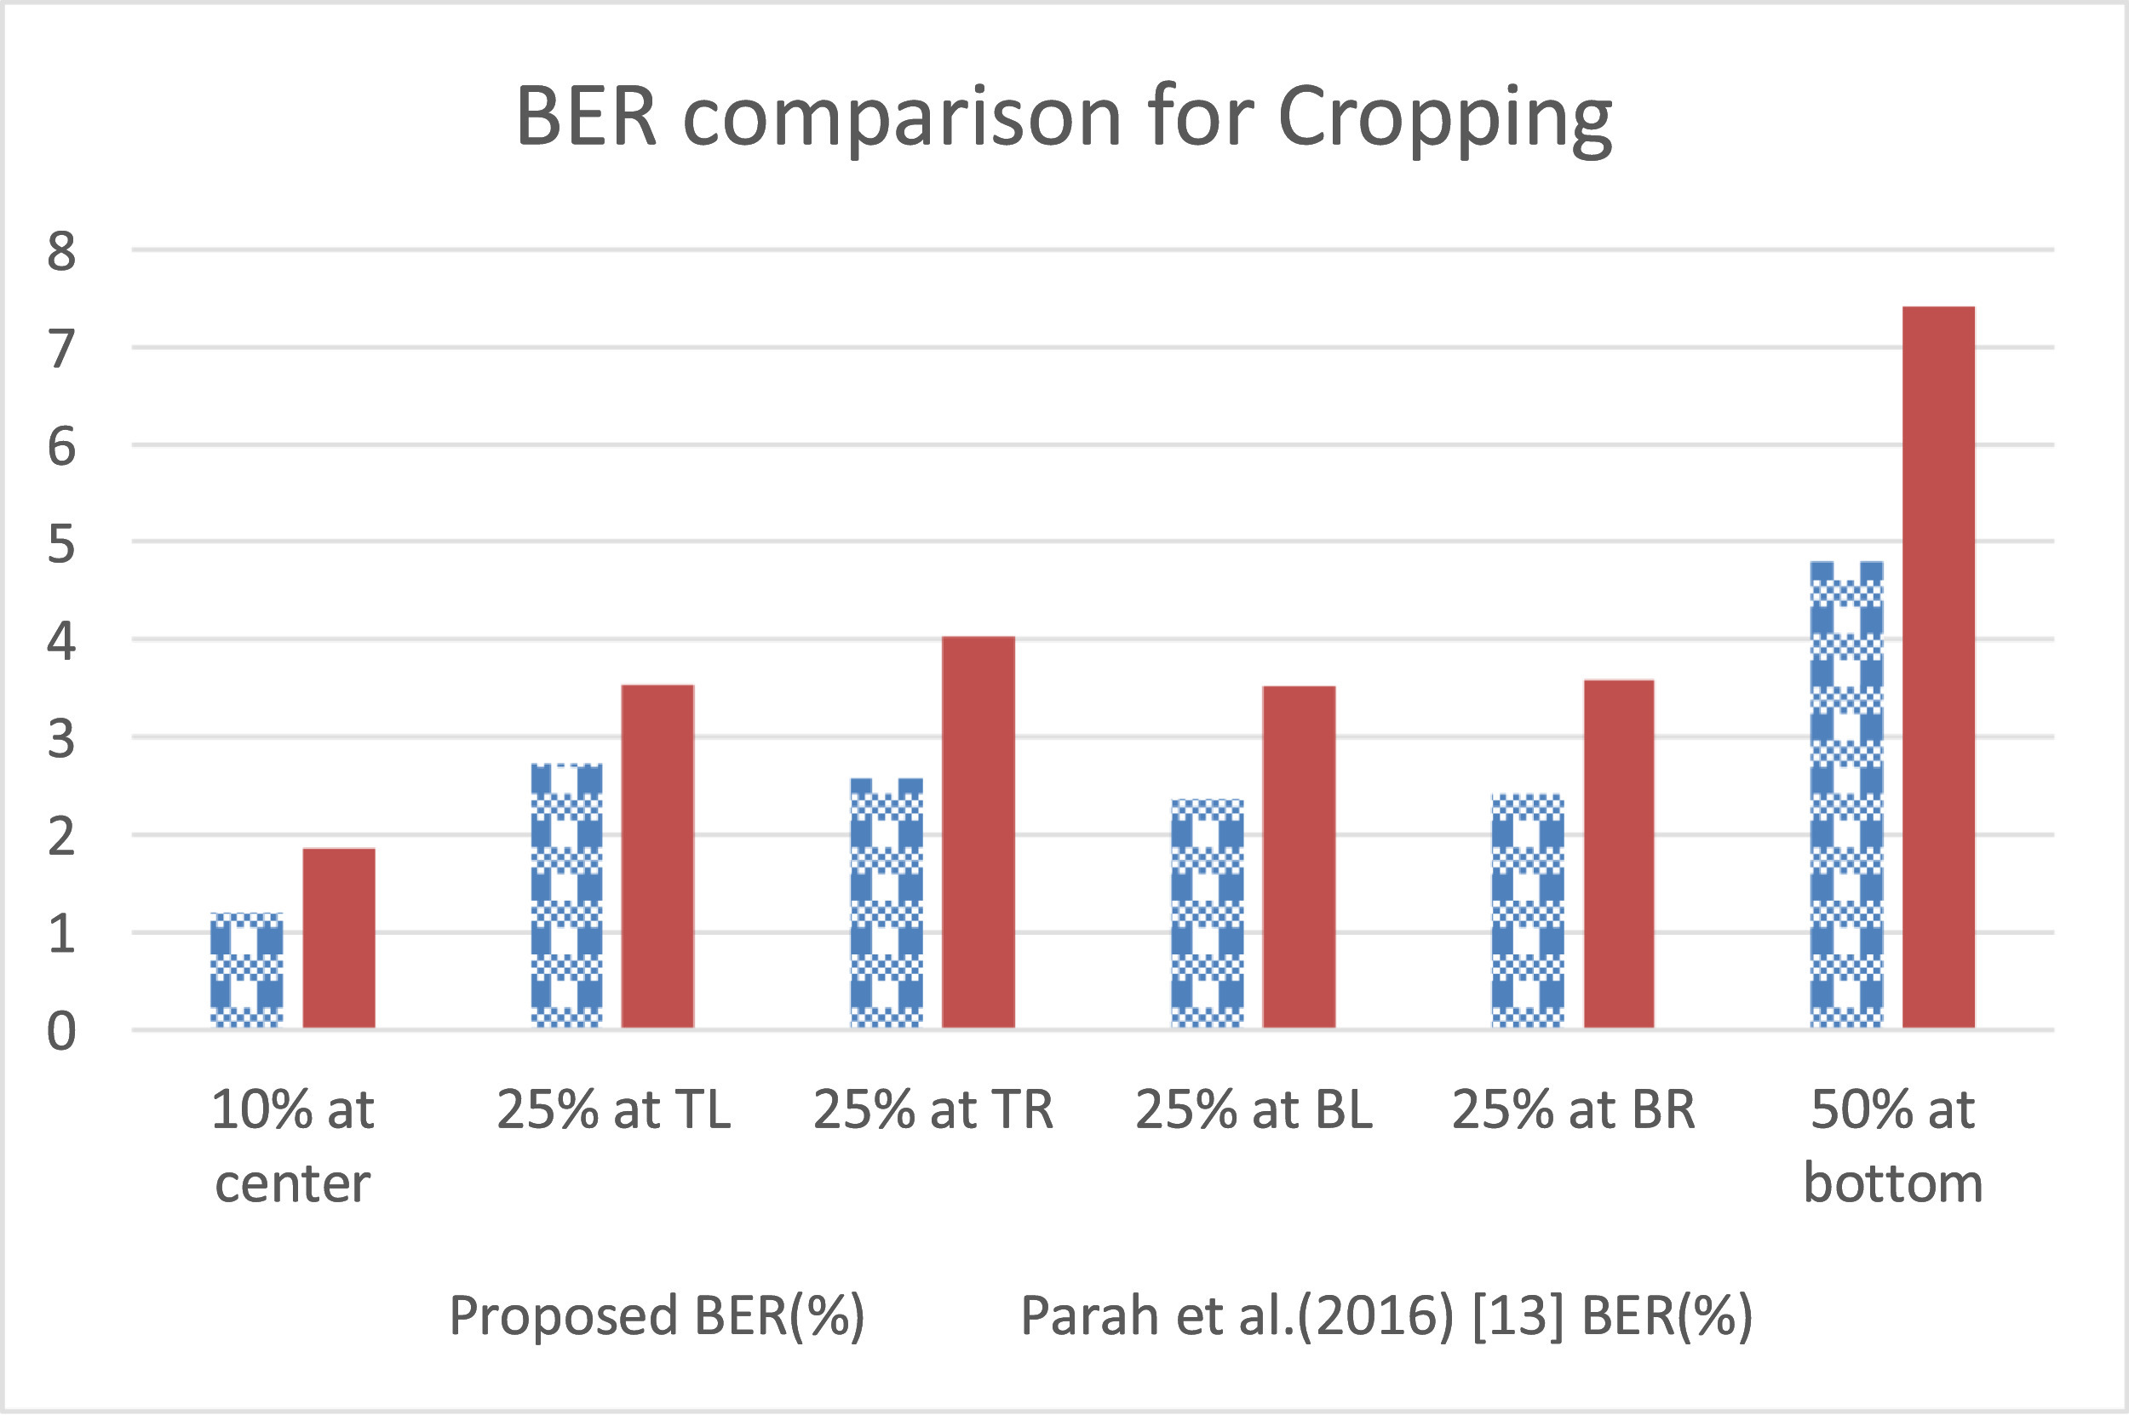
Experimental results and discussions
4.2.1. Watermark extraction after cropping attacks
Notes:
with a cropping operation (Lena image) is shown The image on the right . The proposed method has a lower BER value and is approximately improved by 32%.

Slide 27
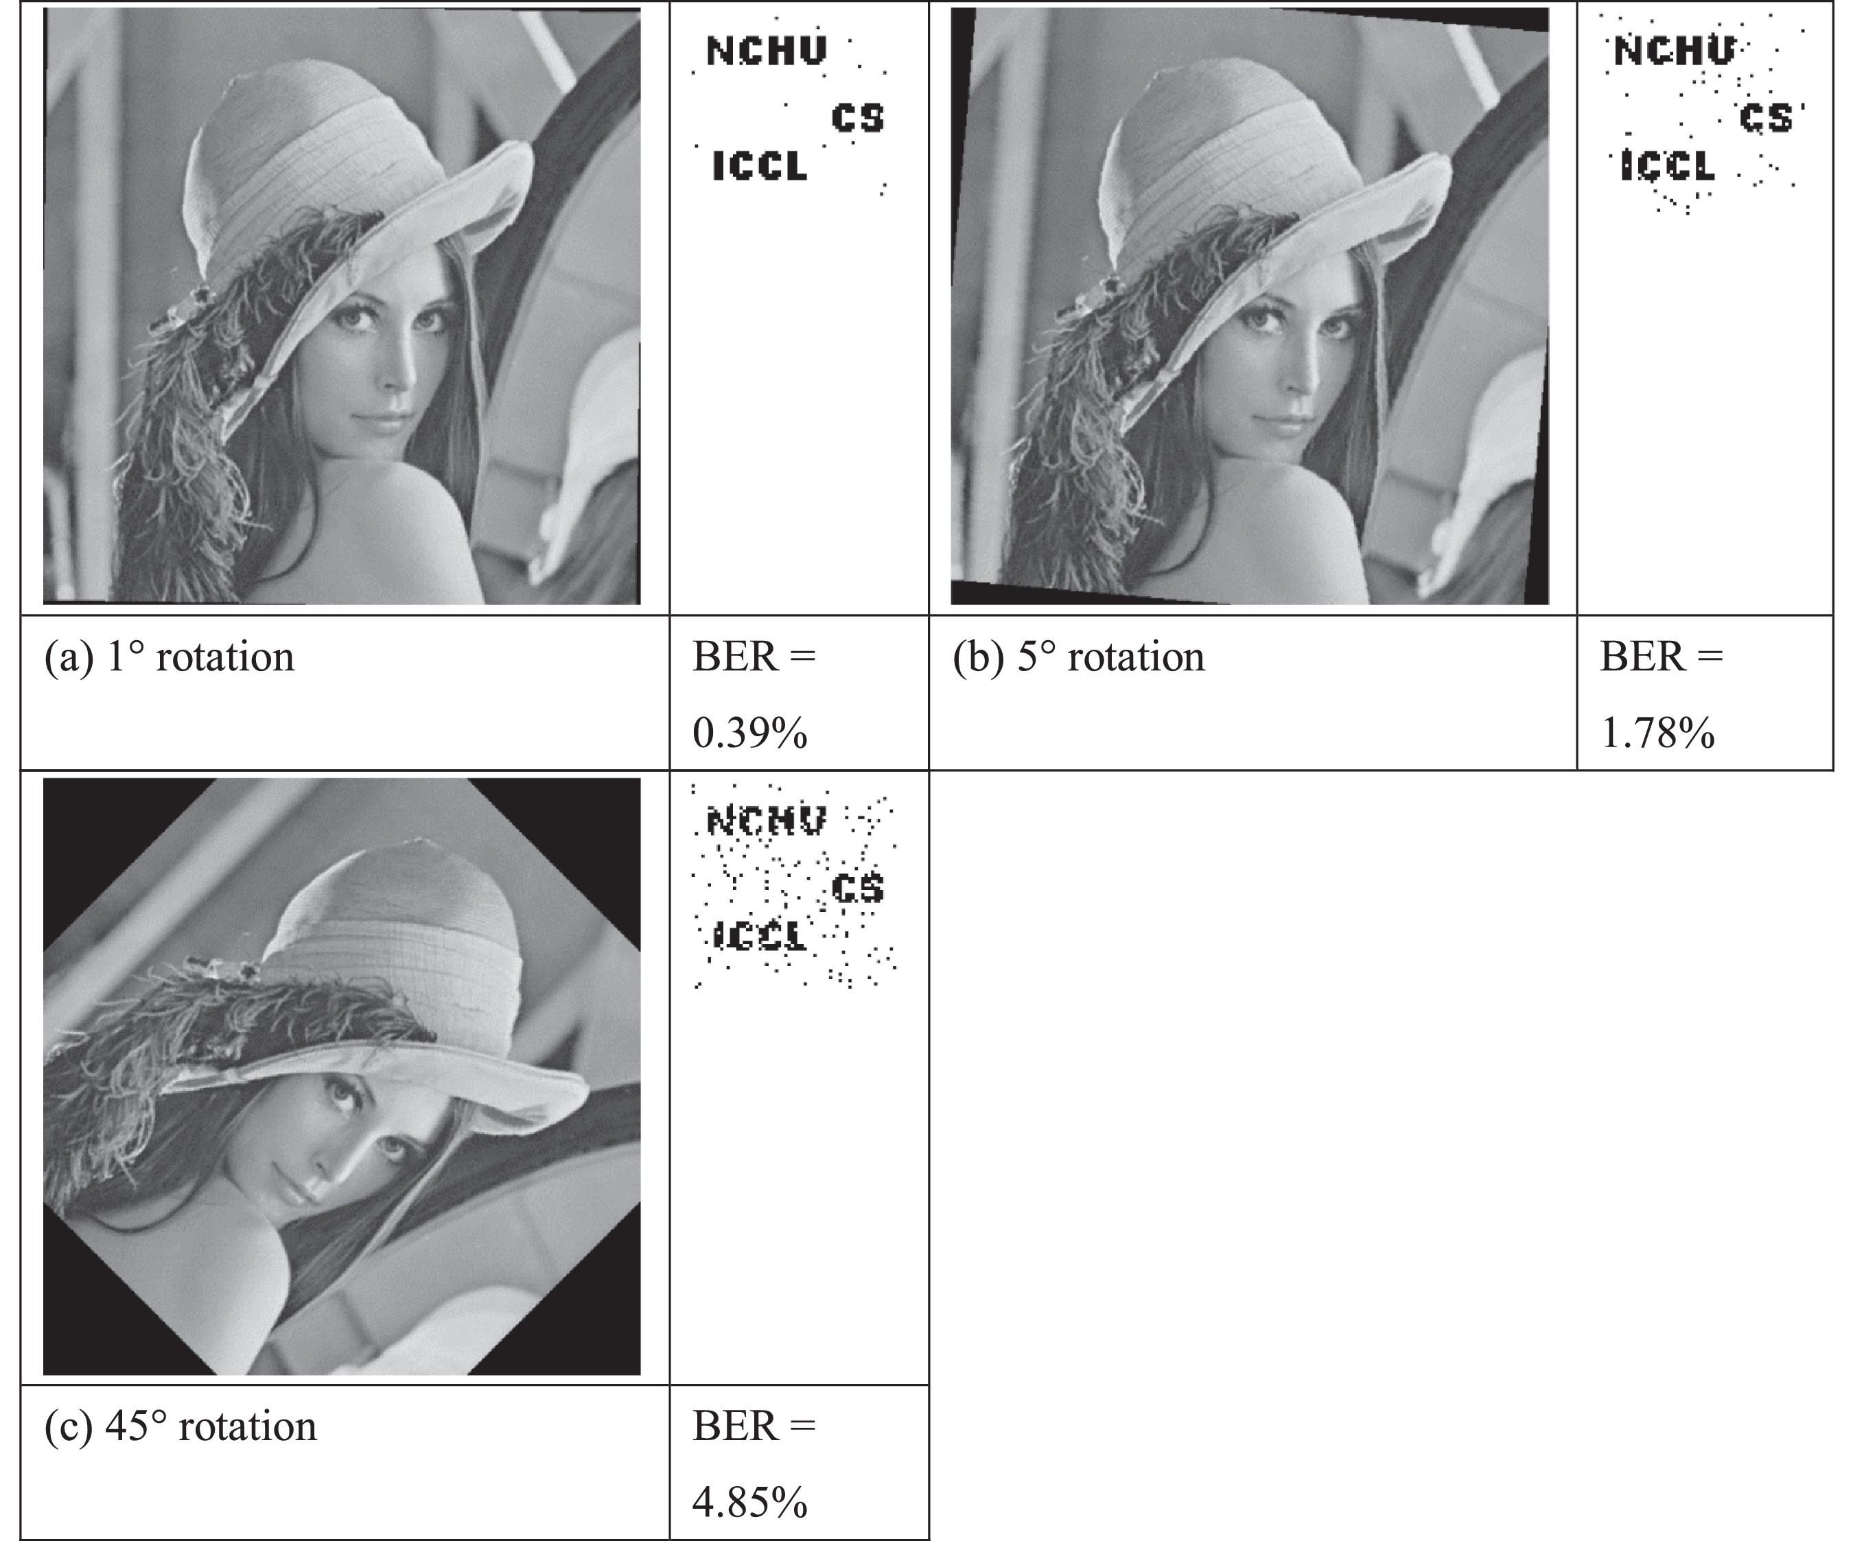
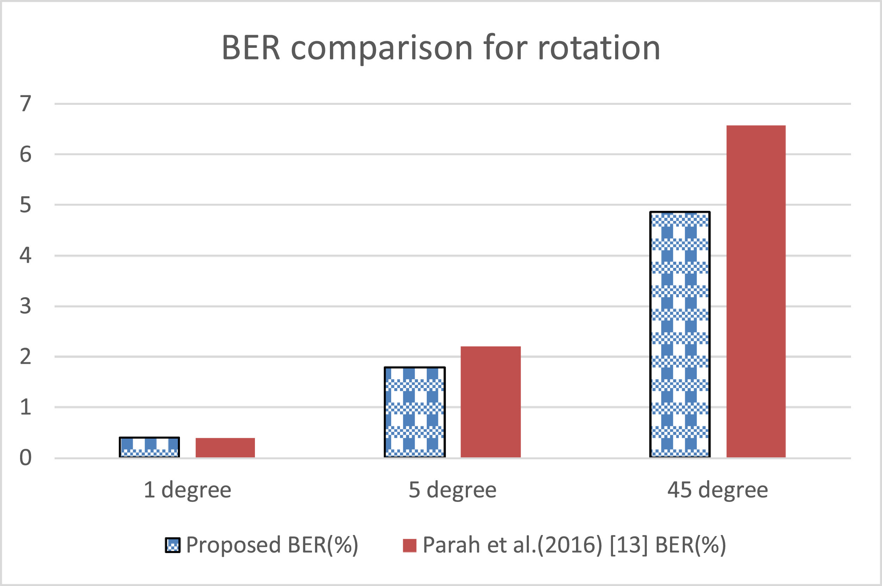
Experimental results and discussions
4.2.2. Watermark extraction after rotation attacks
Notes:
The picture on the left shows the watermarks taken out after rotating 1°, 5°, and 45° clockwise after passing the rotation attack test.
It can be seen from the figure on the right that the improvement rate of this method is 23%

Slide 28
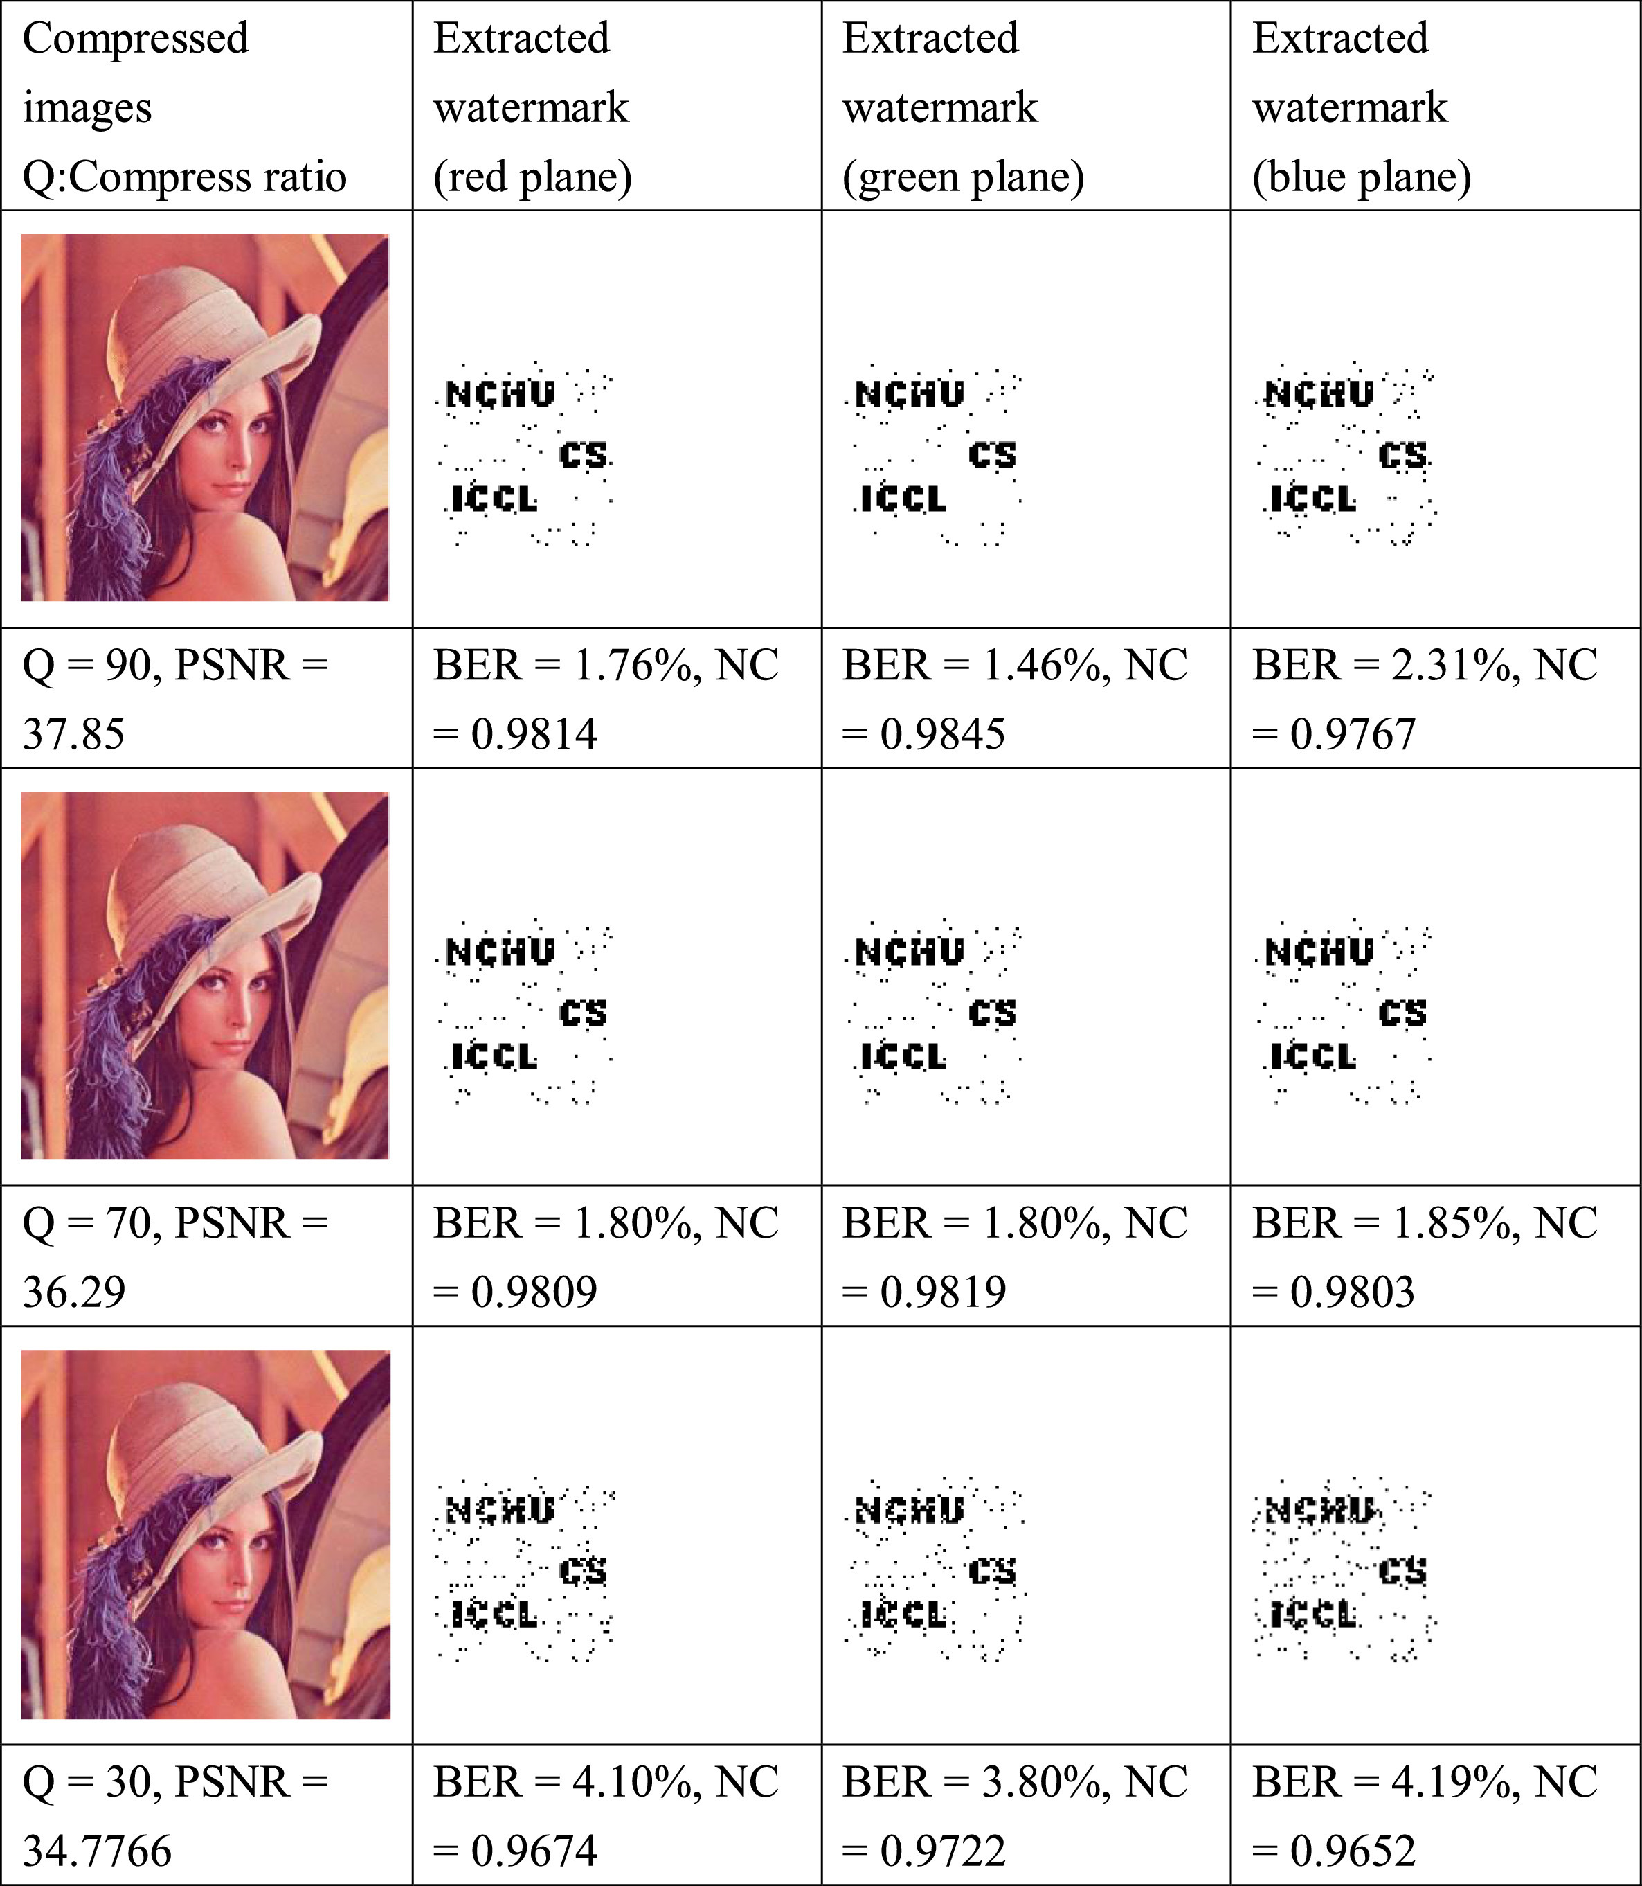
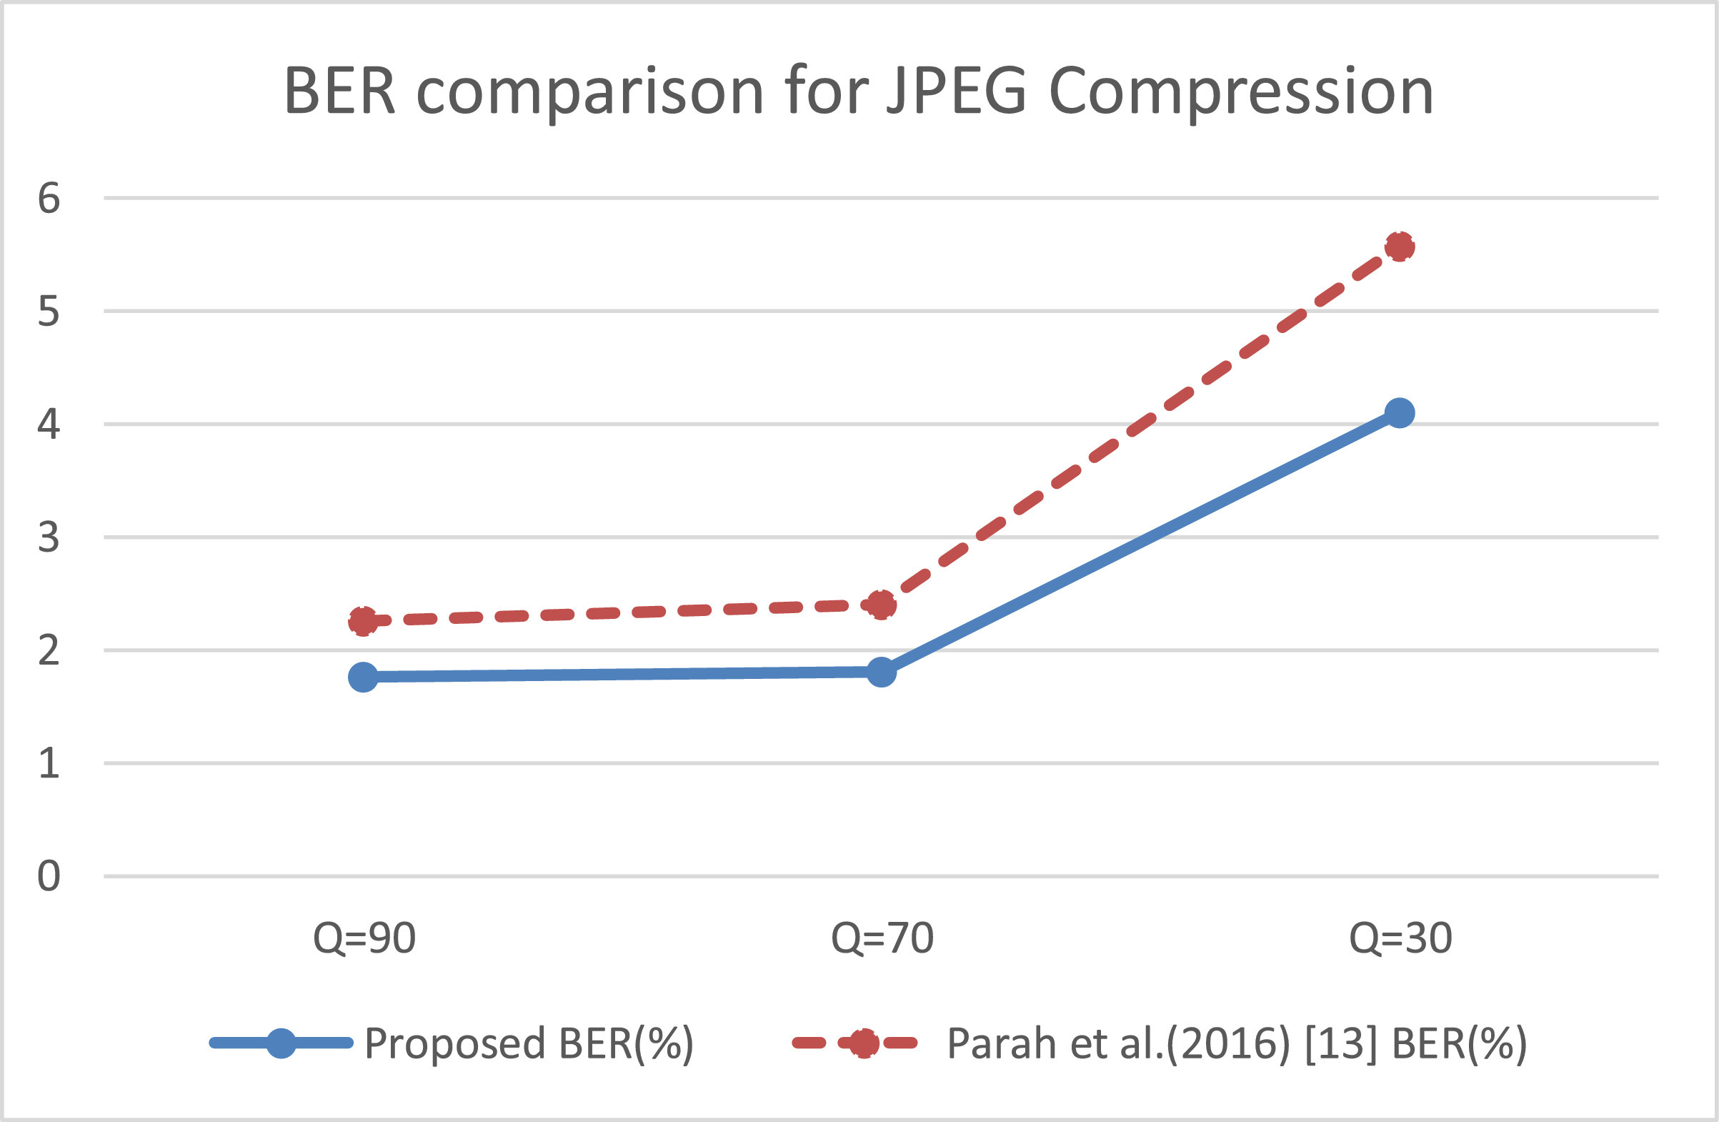
Experimental results and discussions
4.2.3. Watermark extraction after JPEG compression
Notes:
Herein, we test a watermarked image with different JPEG compression quality factors. Herein, the K value was set to 20 for robustness against JPEG compression, and we set Q as the compression ratio of the JPEG.
The picture on the left shows that color watermarked images after JPEG compression can still be used to extract a good quality watermark.
The picture on the right shows that the proposed method demonstrates lower BER values and is approximately improved by 25%.

Slide 29
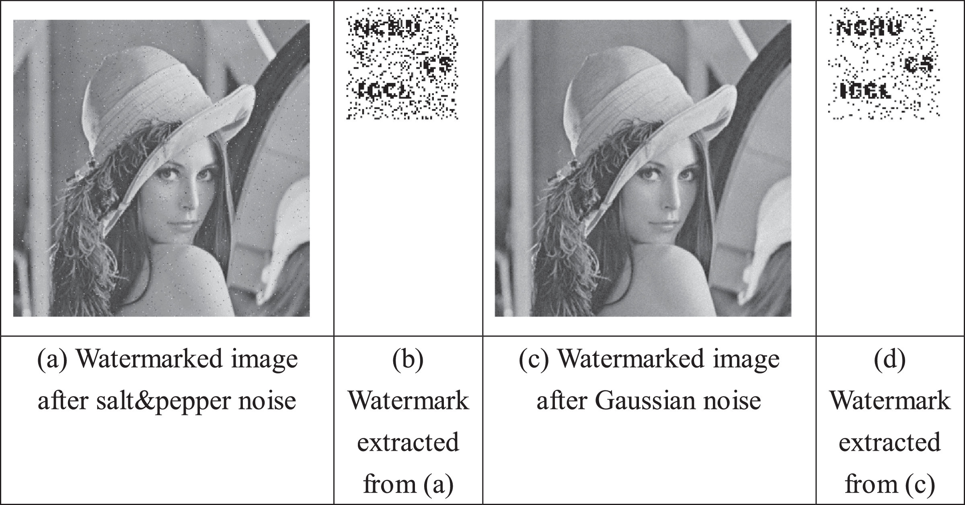
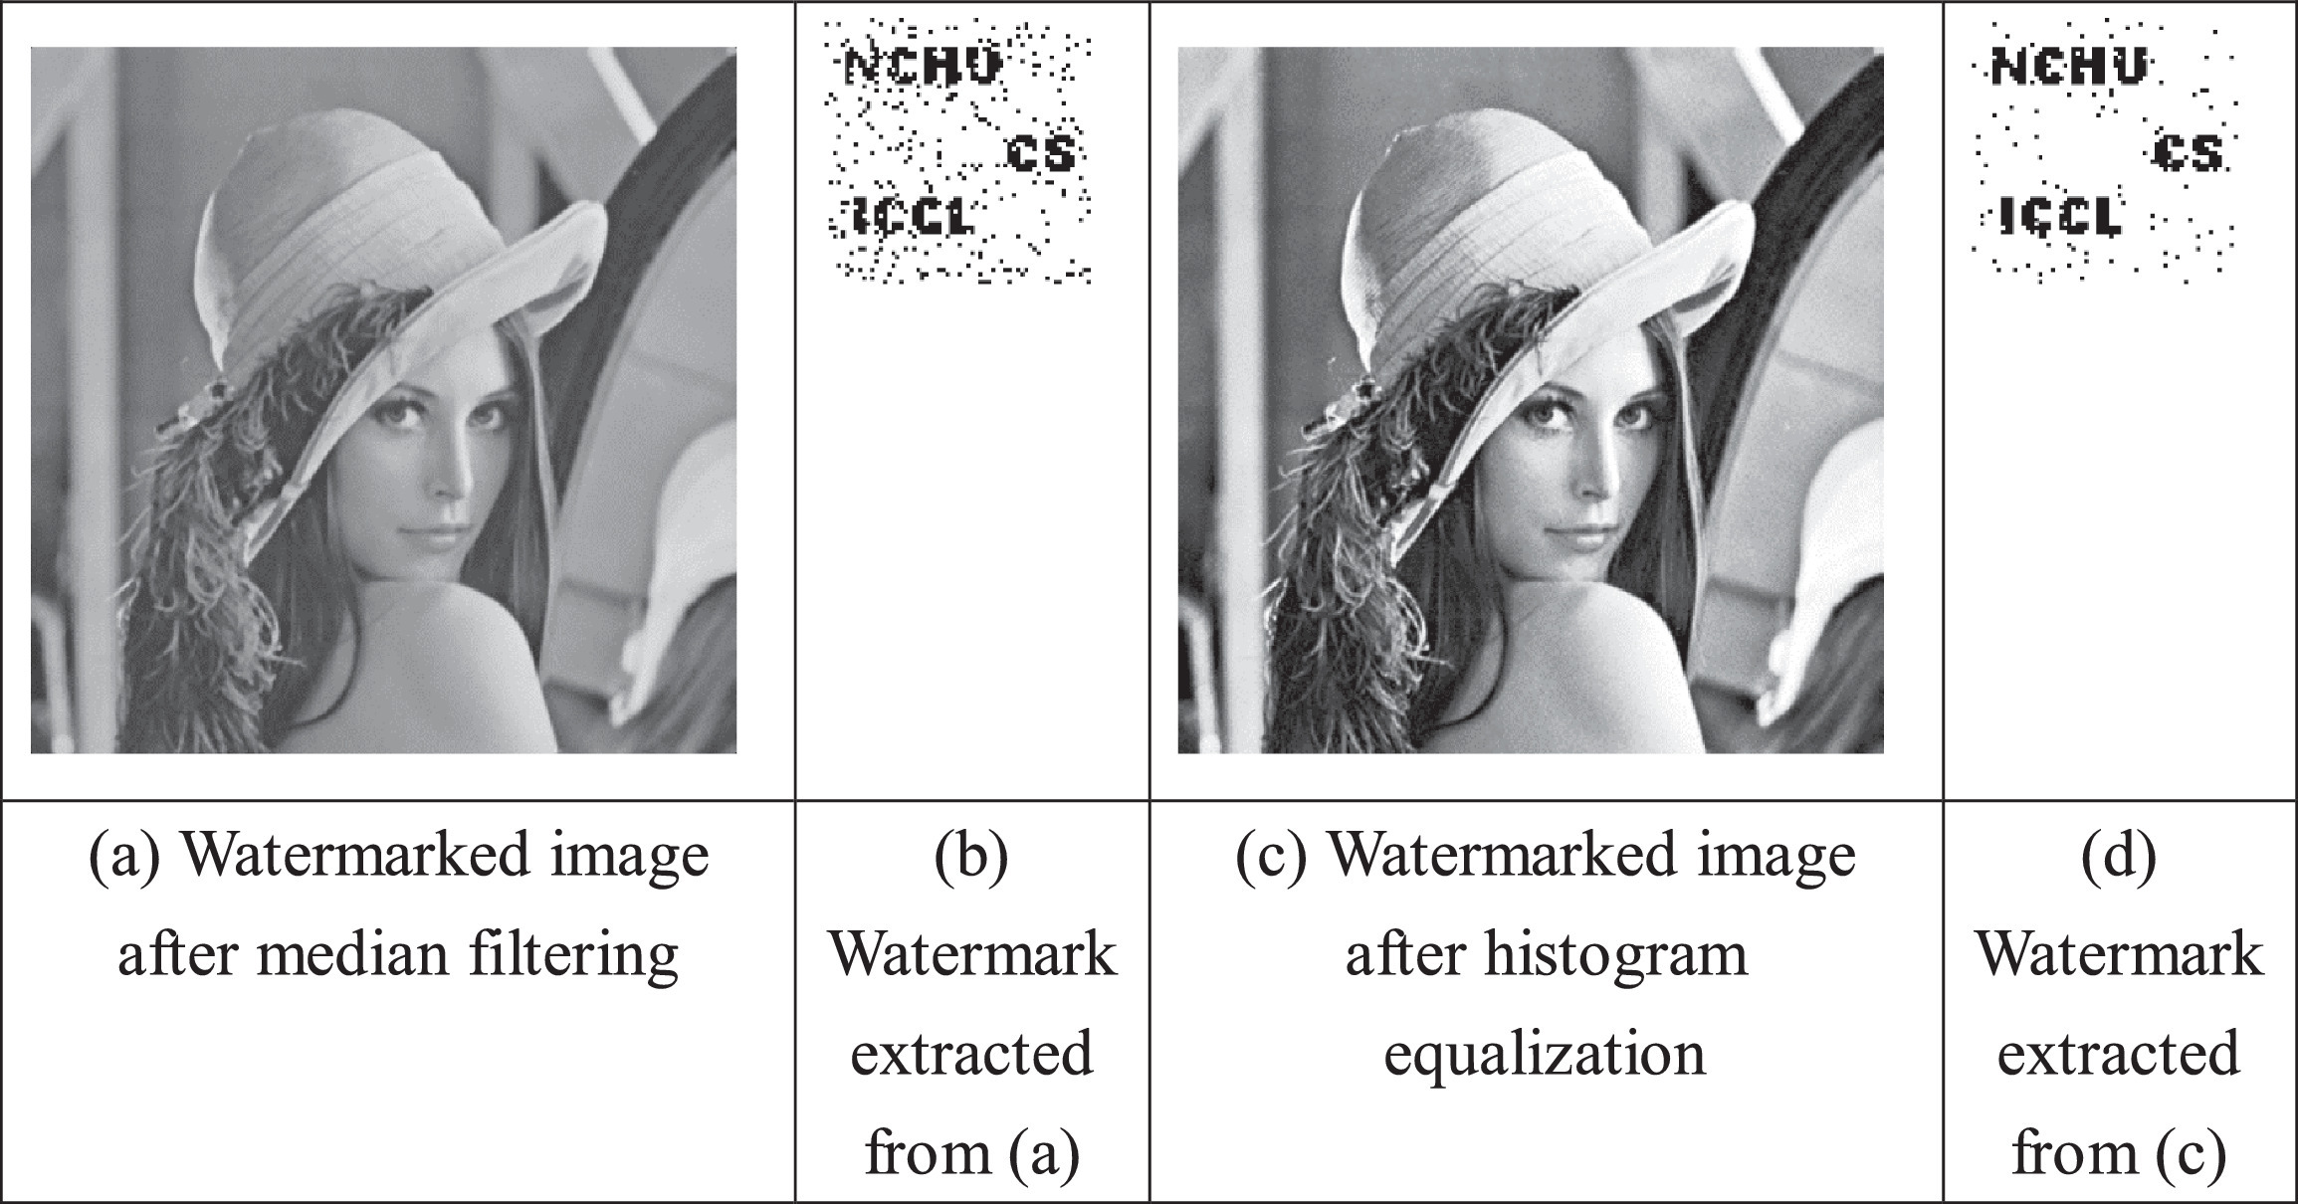
Experimental results and discussions
4.2.4. Watermark extraction after various attacks
(a)(b)salt&pepper noise (a)(b)Median filtering
(c)(d) Gaussian noise (c)(d)Histogram equalization

Slide 30
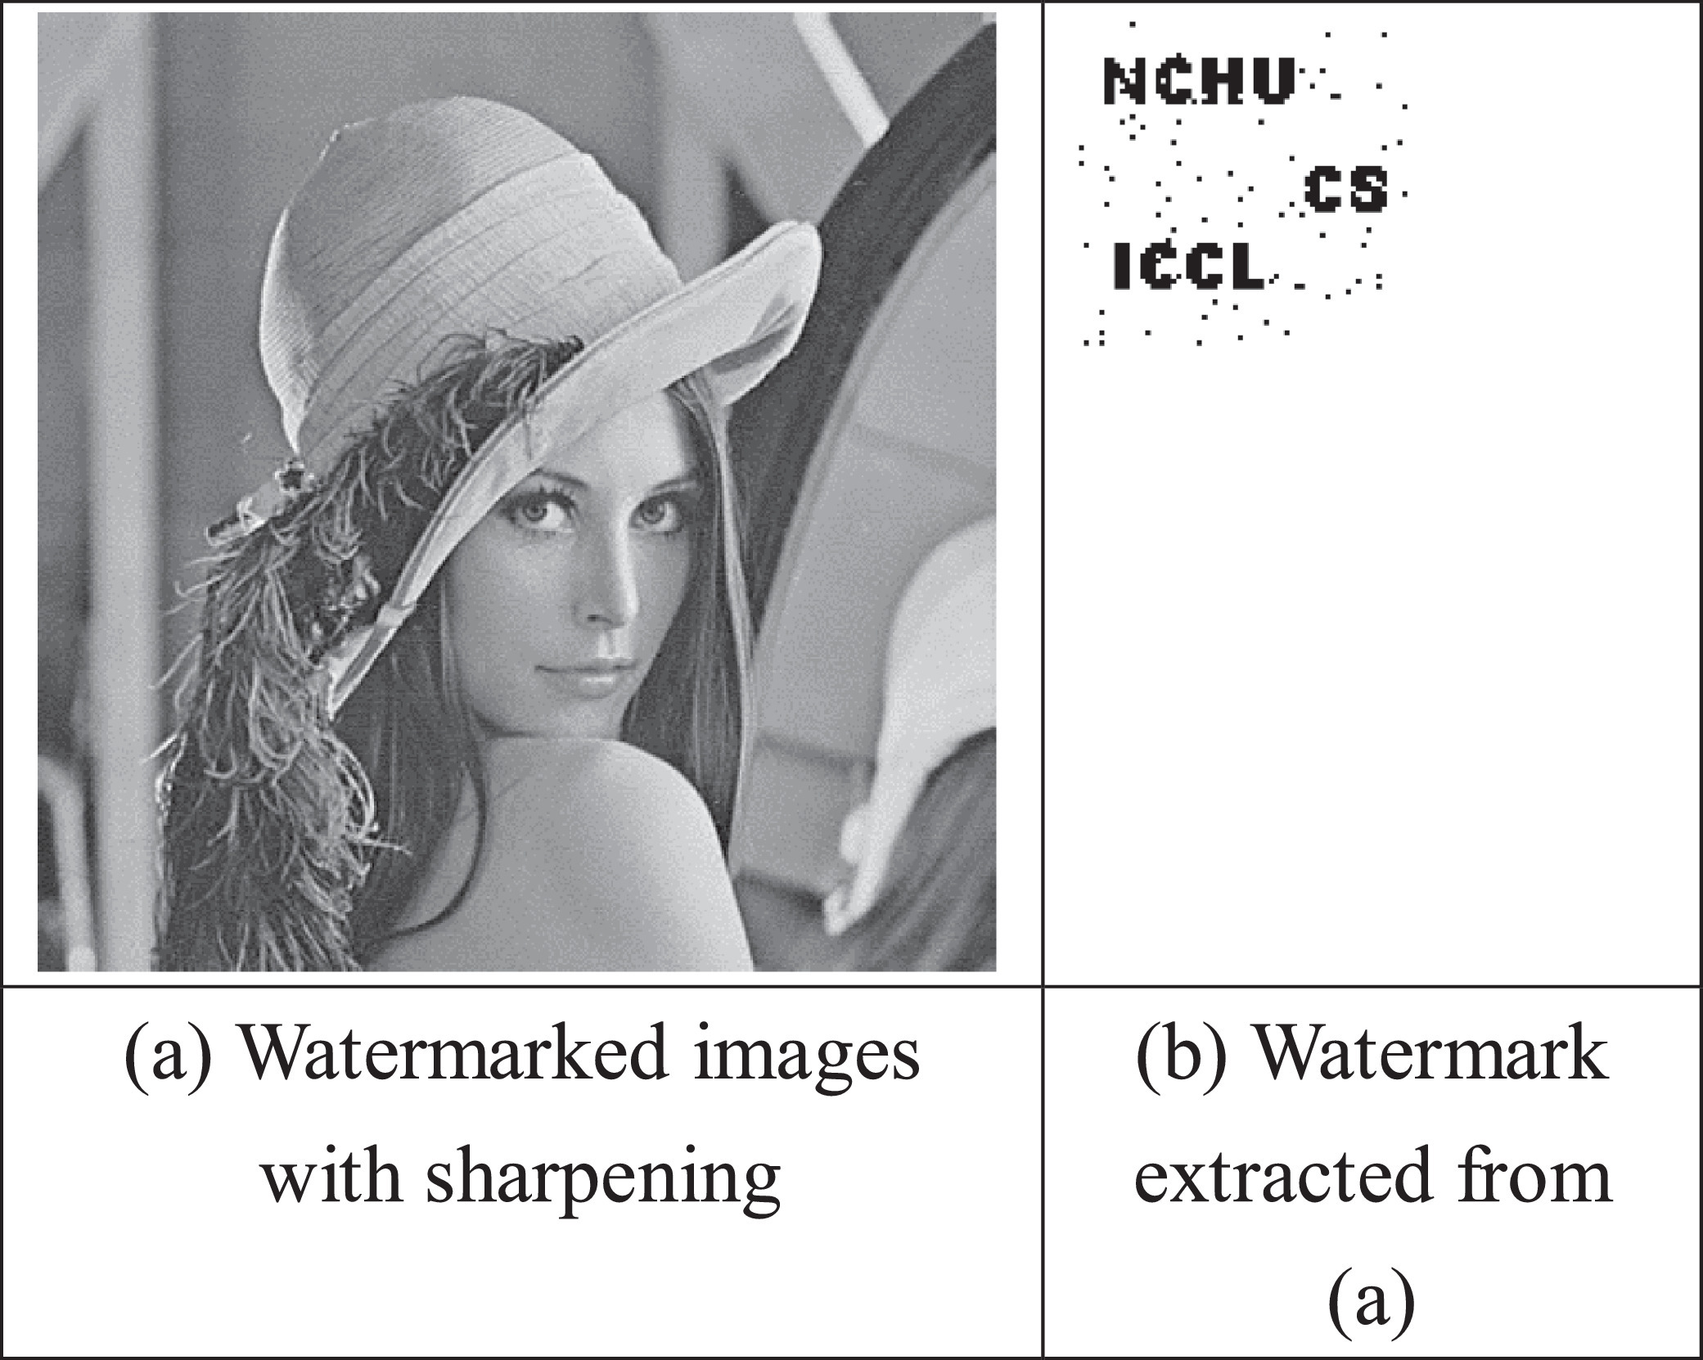
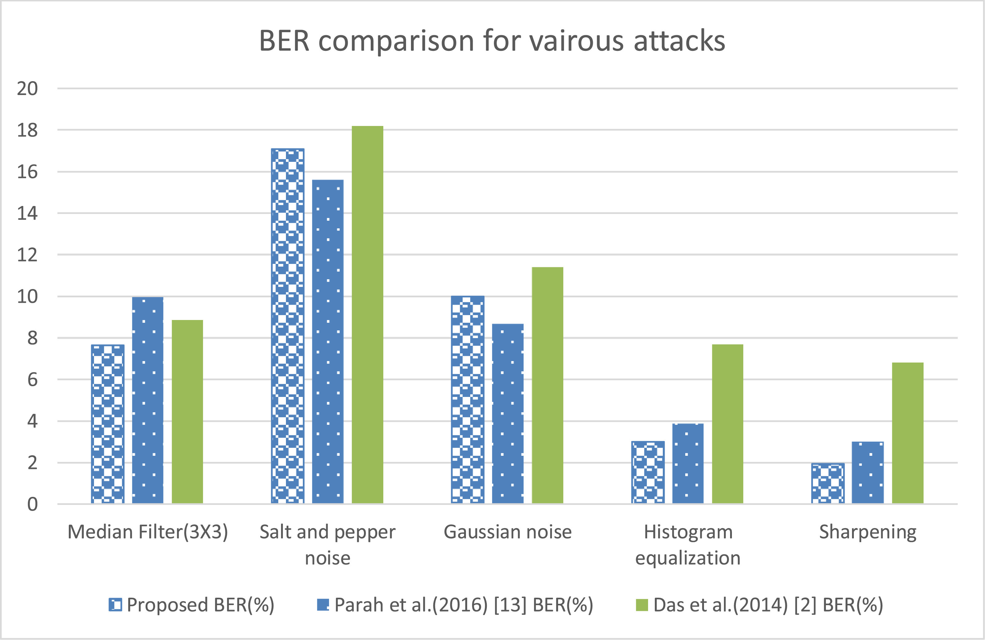
Experimental results and discussions
4.2.4. Watermark extraction after various attacks
Sharpening

Slide 31
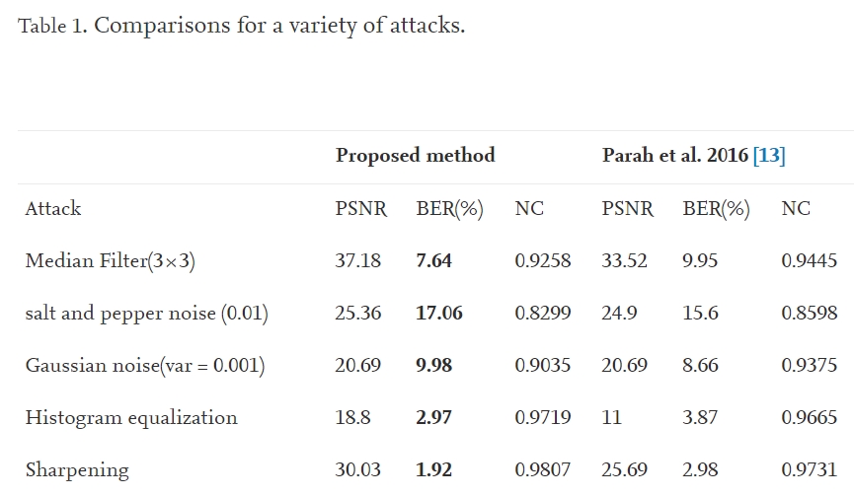
Experimental results and discussions
4.2.4. Watermark extraction after various attacks

Slide 32
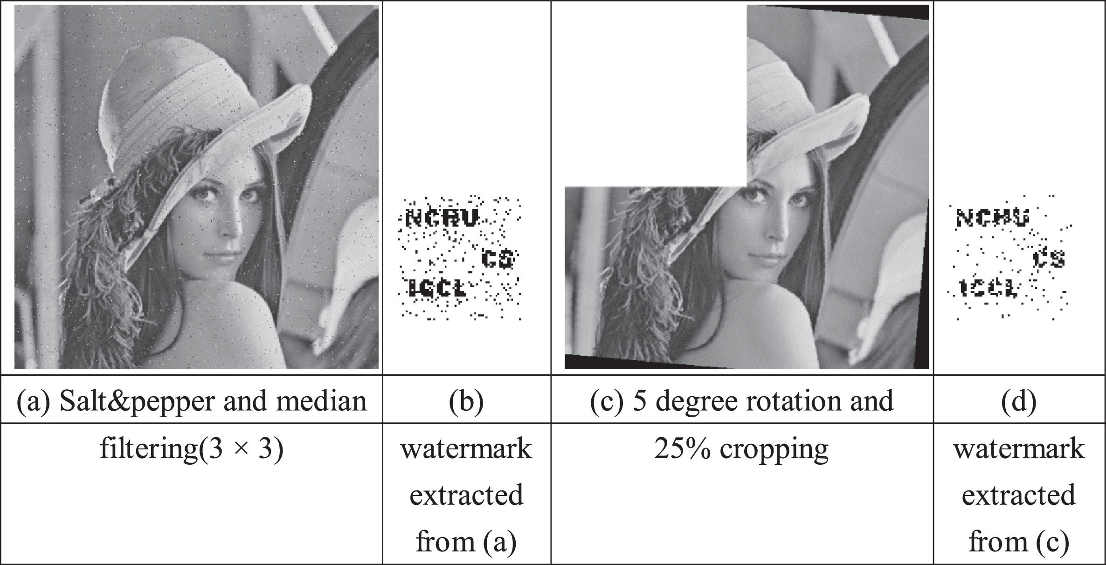
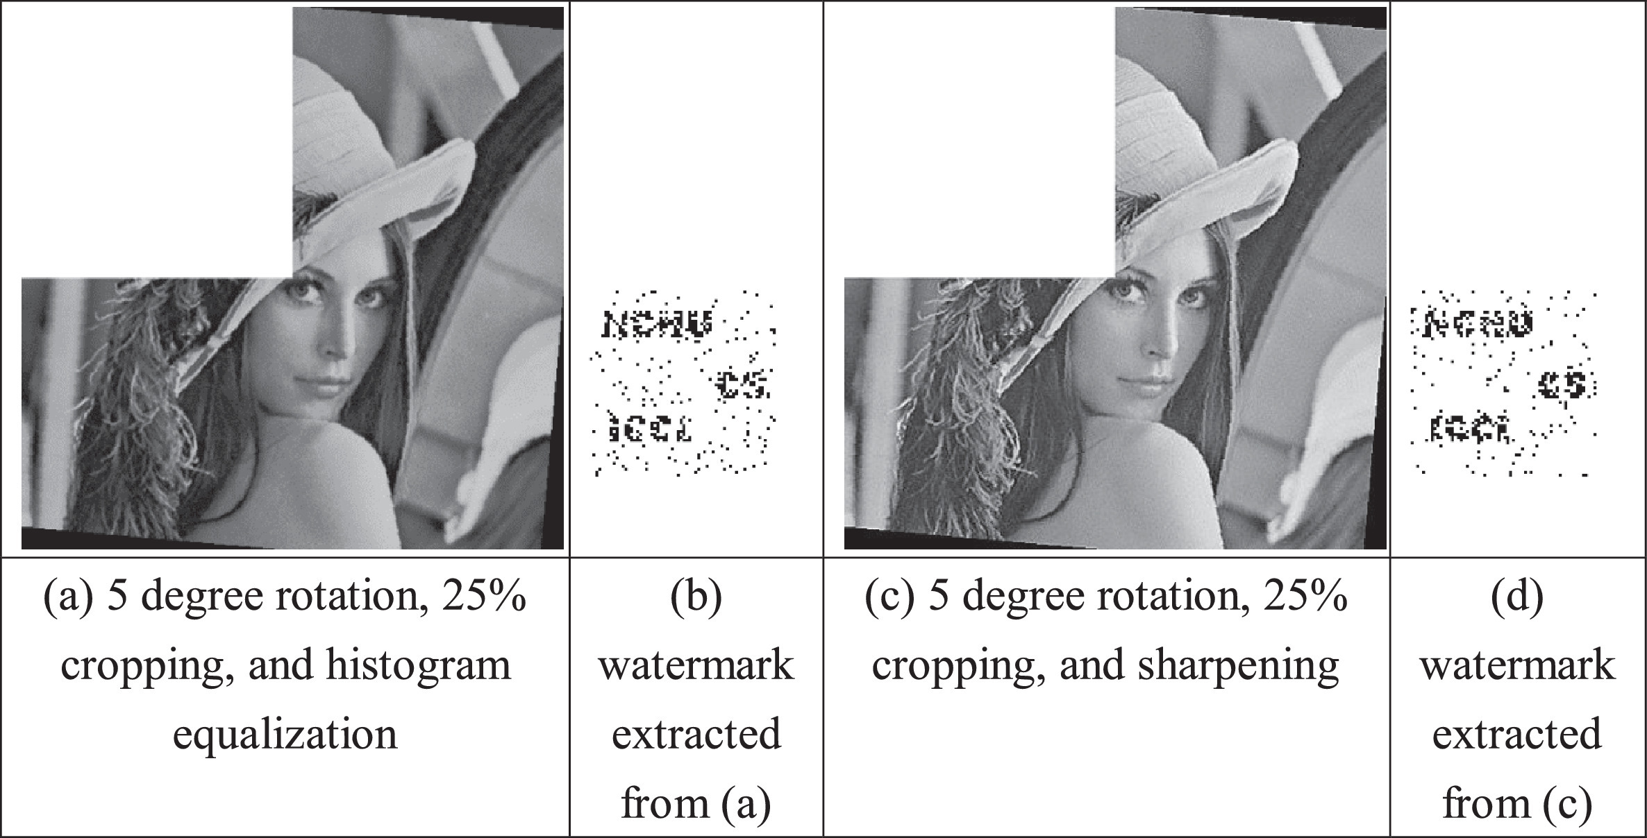
Experimental results and discussions
4.2.5. Watermark extraction after combined attacks
(a)(b) Salt&pepper noise and median filtering
(c)(d) 5° rotation with 25% cropping
(a)(b) 5° rotation, 25% cropping, and histogram equalization
(c)(d) 5° rotation, 25% cropping, and sharpening

Slide 33
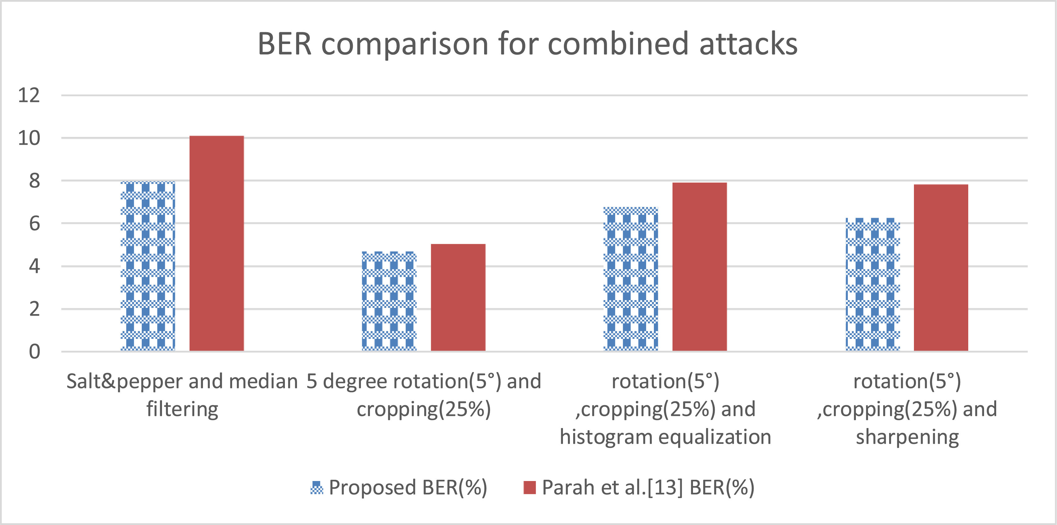
Experimental results and discussions
4.2.5. Watermark extraction after combined attacks
Notes:
A BER comparison for various combined attacks is shown in this picture. The proposed method has better BER values in all cases, and is approximately improved by 16%.

Slide 34
Conclusion

Slide 35
Conclusion
The averaged BER of cropping and rotating attacks obtained an improvement ratio of over 23%.
The averaged BER of the extracted watermark after combined attacks remains an approximate improvement of 16%.
PSNR obtained herein remains higher than that obtained by Parah et al.
The proposed method is more effective for the copyright protection of digital images.

Slide 36
Thank you for listening

